Slide 1



Slide 2

01
Max De Marzi
Neo4j Field Engineer
maxdemarzi.com
This is my brain dump, read it
02
03
@maxdemarzi
04
github.com/maxdemarzi
About 200 public repositories
About
Me !

Slide 3
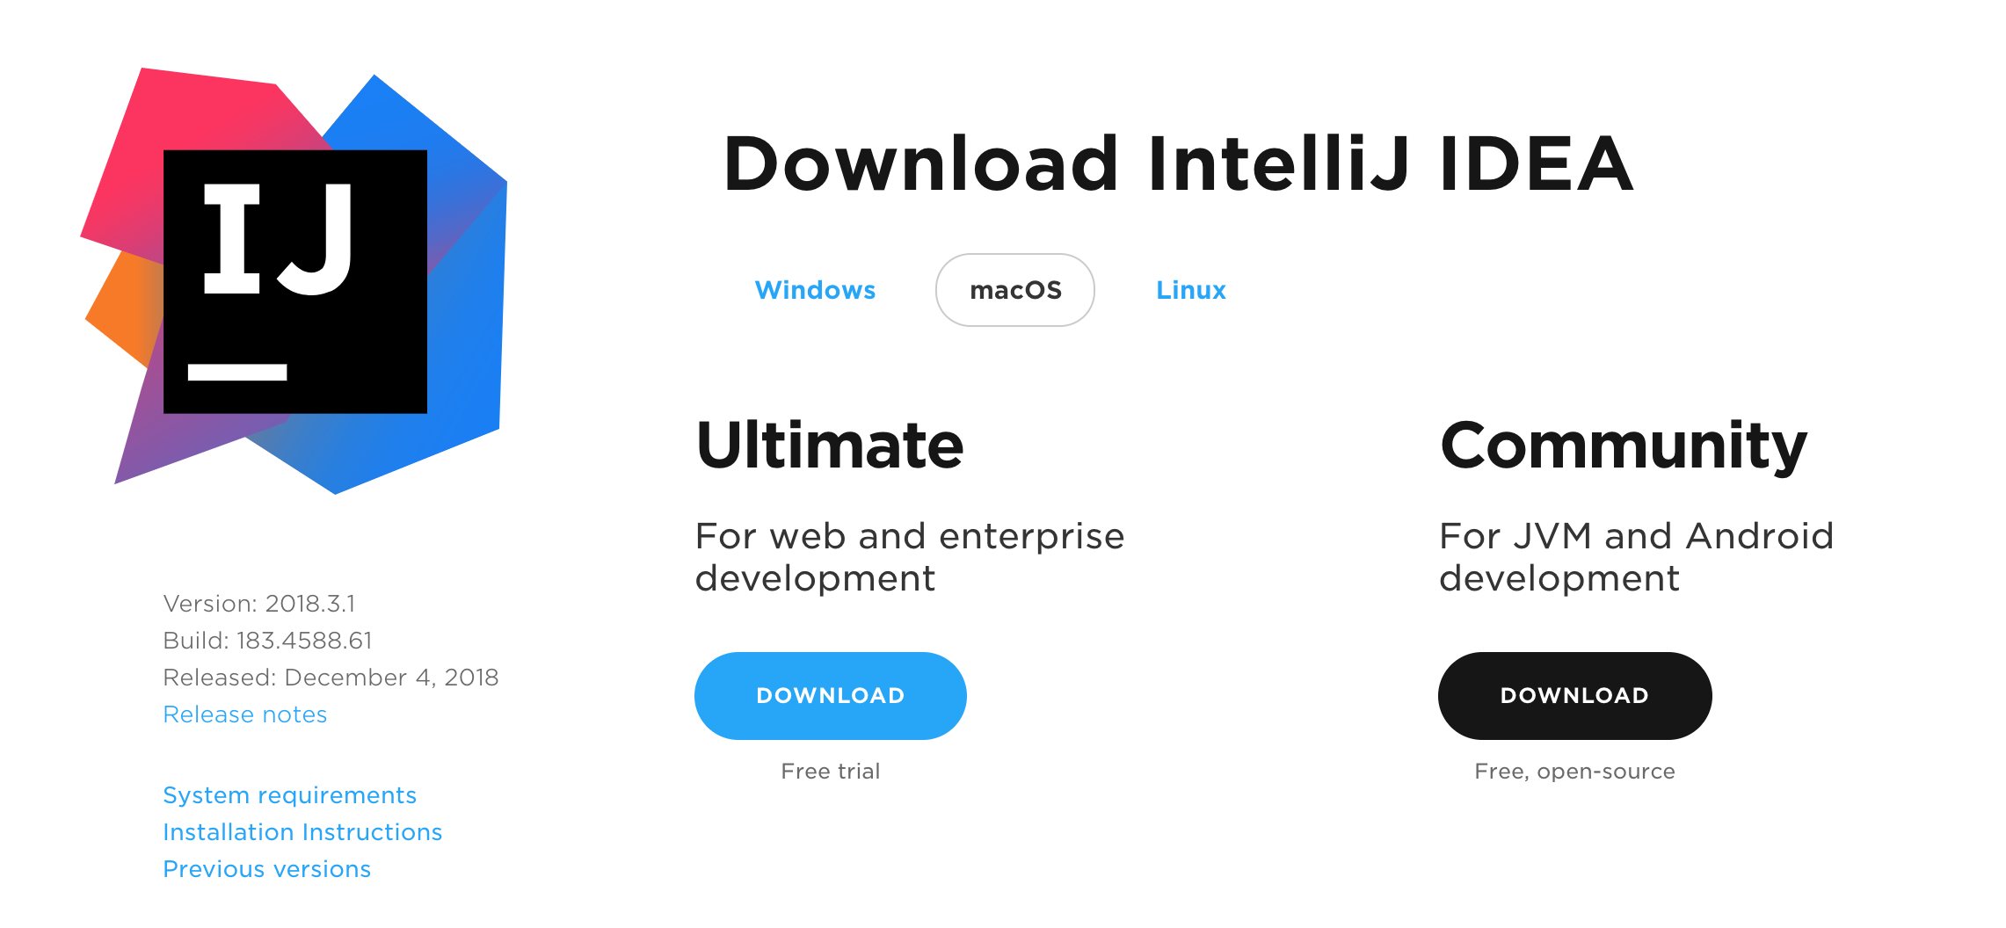
Start Downloading
wifi probably sucks

Slide 4

Agenda
Level Set
Stored Procedures
Traversal API
Lunch
Cheating
Testing
Analytics

Slide 5
But before all that
We need a bit of a come to Jesus moment.

Slide 6




All that matters
You go home, thinking about graphs
You

Slide 7
EAT
SLEEP
GRAPH
REPEAT

Slide 8

Drink the
Kool-aid
You either go all in or
you are wasting everybody’s time.

Slide 9

There is NO money
In the graph database market

Slide 10

Neo4j is 85%
We are the Graph Database Market.

Slide 11

What about Cosmos?
What about Neptune?
It’s “MeTooWare”
Microsoft and Amazon can check a box, but it’s not their focus.

Slide 12

There is moneY
In the Cloud Market

Slide 13
$100 Billion >>
$39 Million
Oh, my, God Becky, look at the cloud market.
I mean, the cloud market, is just so big
I can’t believe it’s just so round, it’s like out there
I mean gross, look
It’s just so, so much money

Slide 14

Amazon, microsoft,
ibm, oracle
Do not care about the Graph Database Market.
They will not invest in it beyond the bare minimum to say MeToo.
Graphs have no future in their hands.

Slide 15

What about DataStax?

Slide 16

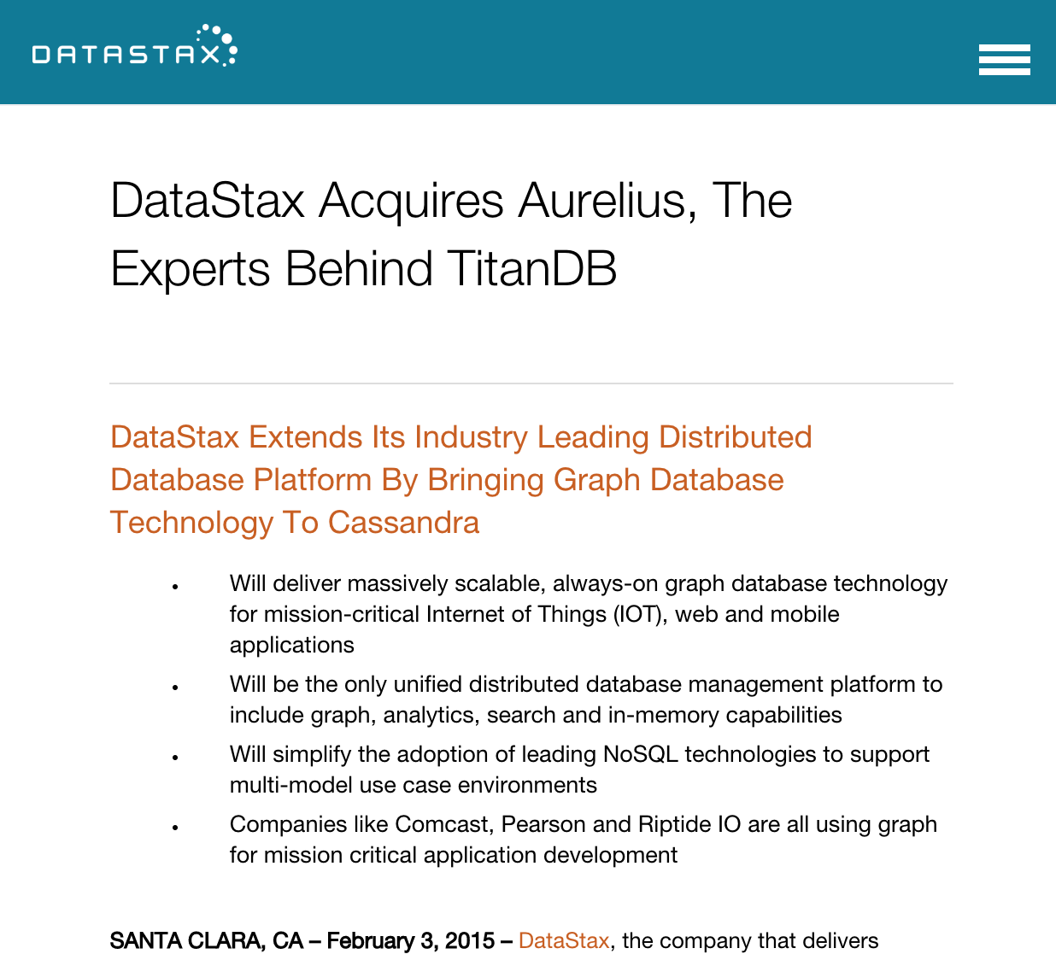


Slide 17

What about janus graph?

Slide 18

Abandon-ware
Do you really want to put this in Production?
Because there is no-one
supporting this stuff.

Slide 19
What about…
Dgraph or Cayley or RedisGraph or MemGraph or AgensGraph or GUN or Bitsy or …

Slide 20

There is no money
In Open Source Infrastructure Software.
AWS will eat your children if you try.

Slide 21
That was depressing

Slide 22

How about some kittens?

Slide 23
Wait, why are we doing this Again?

Slide 24

Take care of the users
They will take care of everything else.

Slide 25
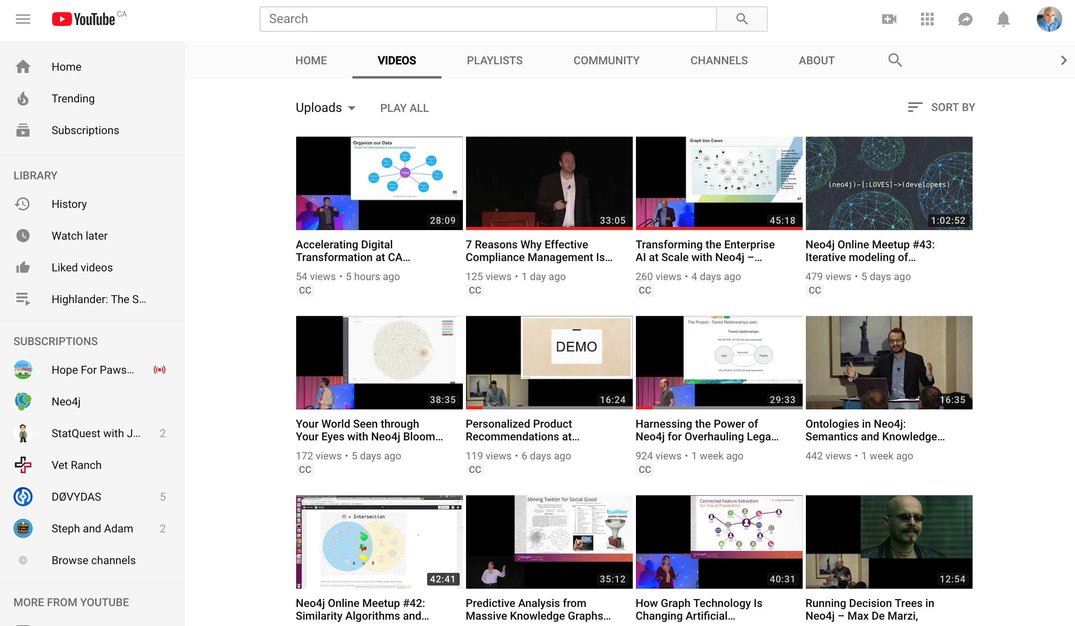

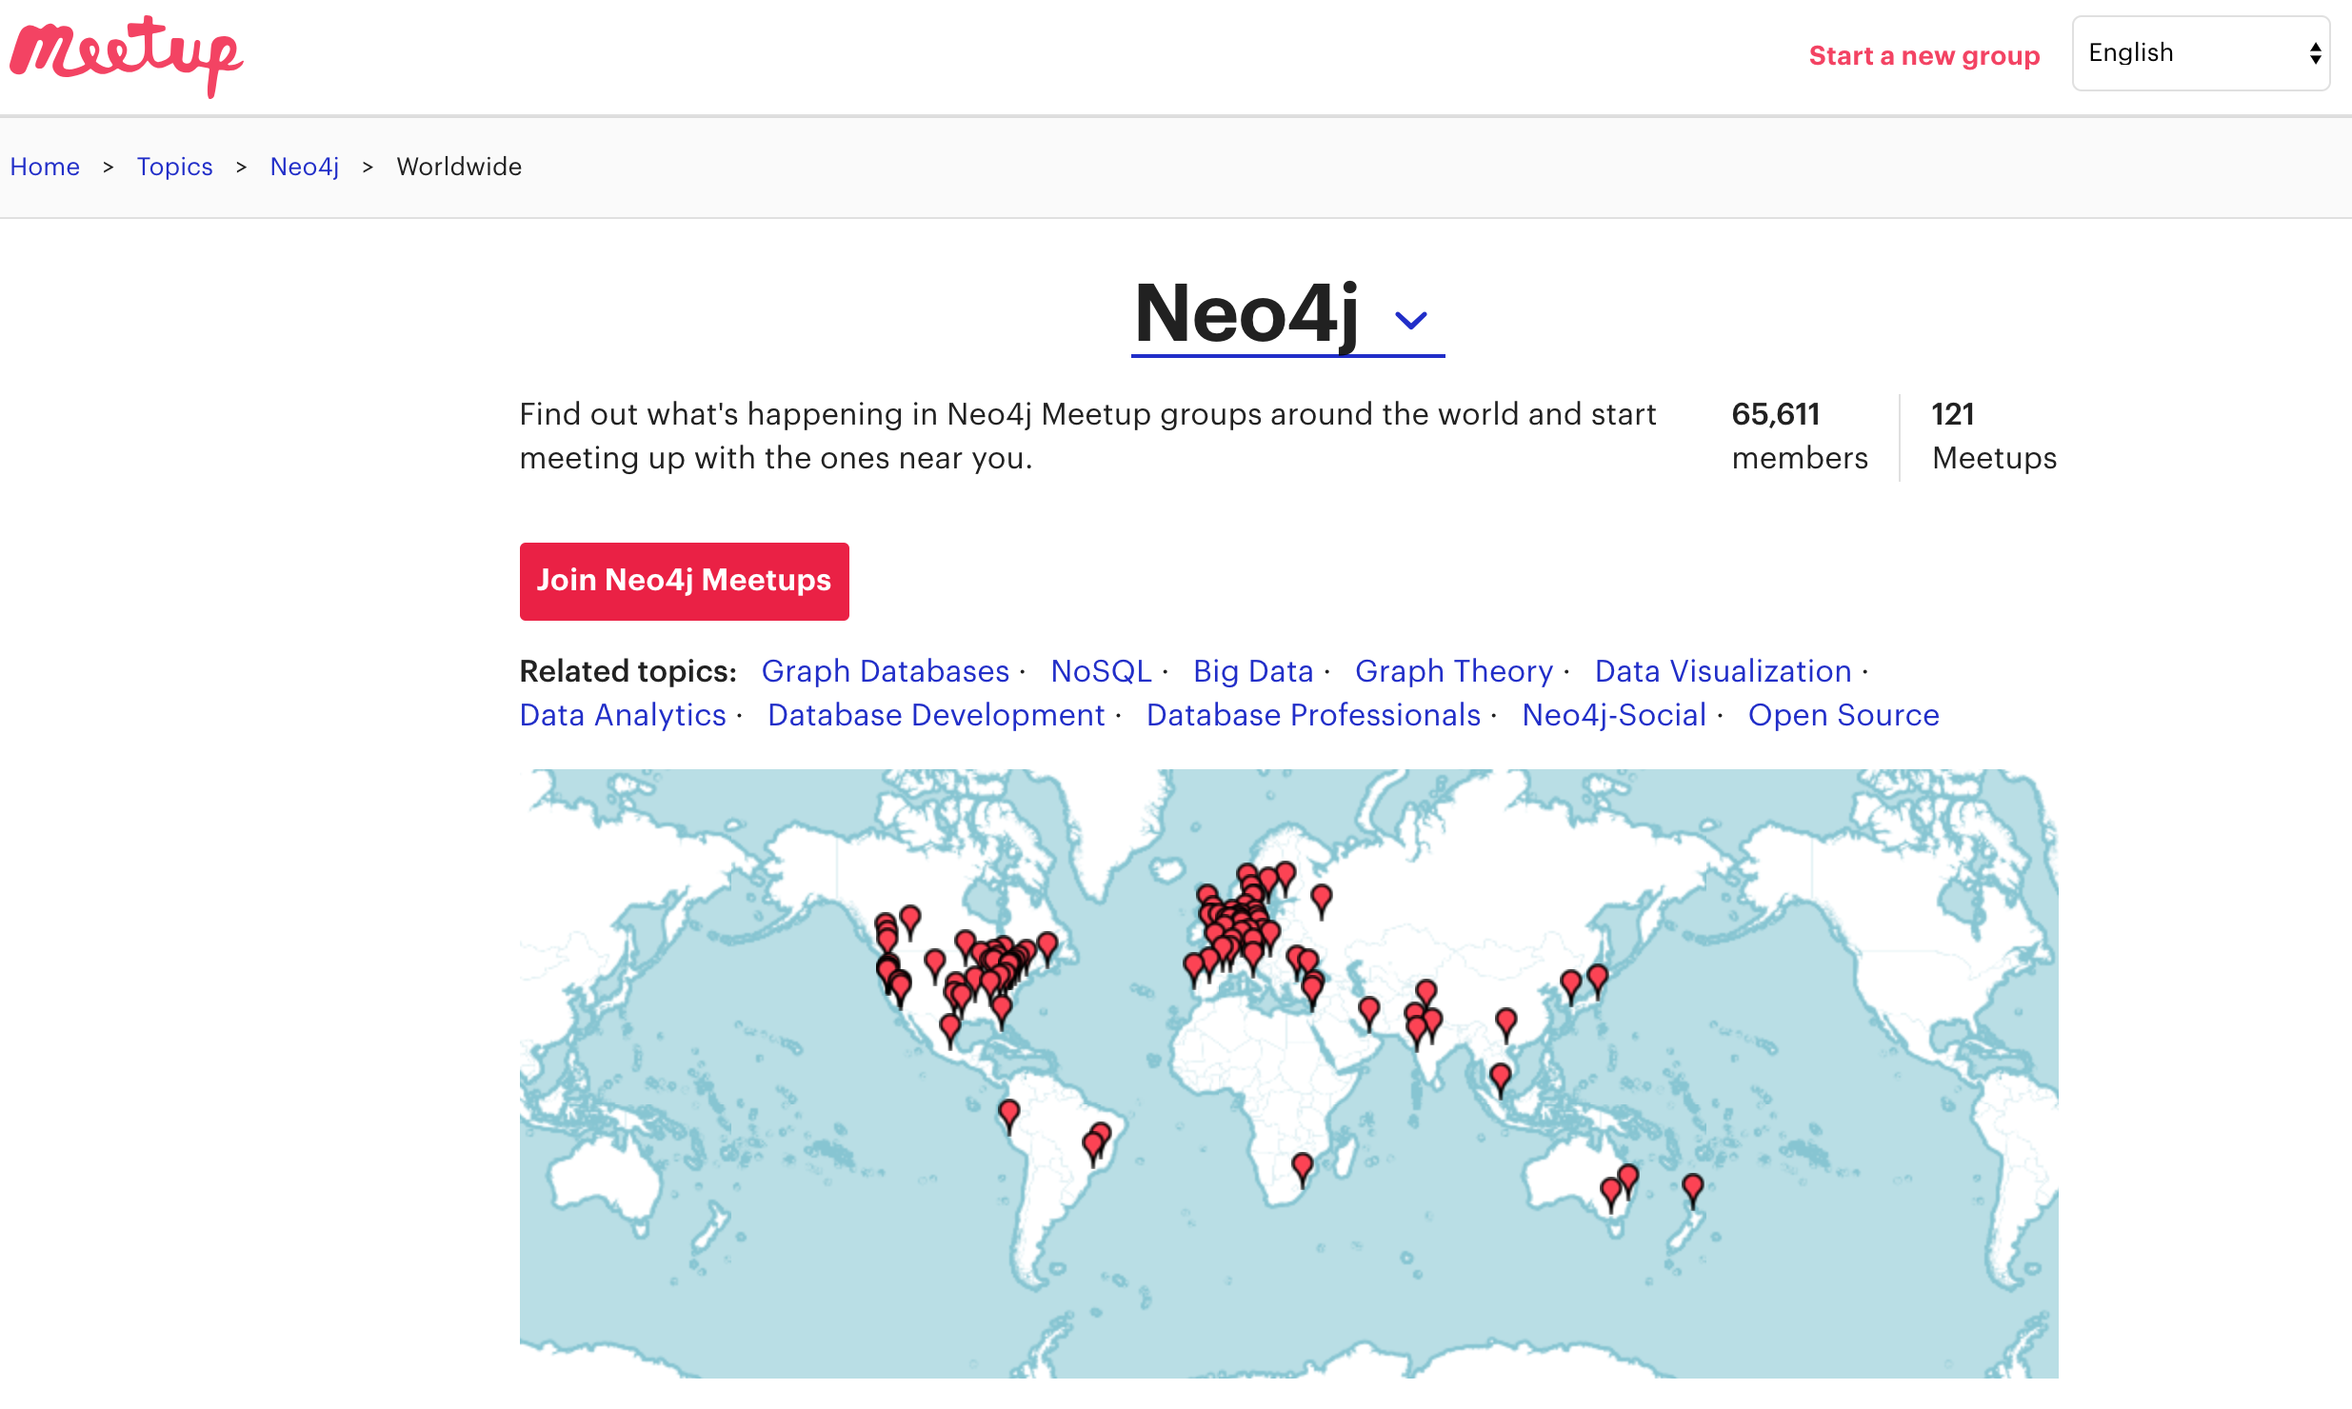
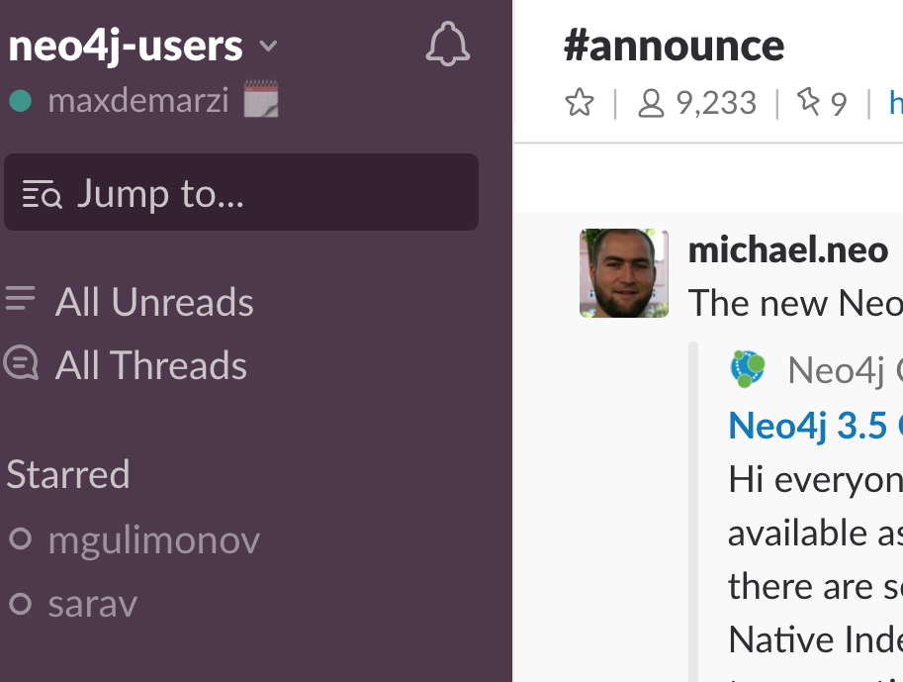
For the USERS:
x00 Enterprise
Customers
9,233 Slack Users
623 Videos
12000 Subscribers
475 Slide Shares
850 Slide Followers
121 Meetup Groups
2000 Certified
Developers

Slide 26

If you’ve chosen graphs
Neo4j is the red pill.
Everything else is just a dream.

Slide 27
Level Set
Internals, Secret Sauce, Modeling for Scale

Slide 28
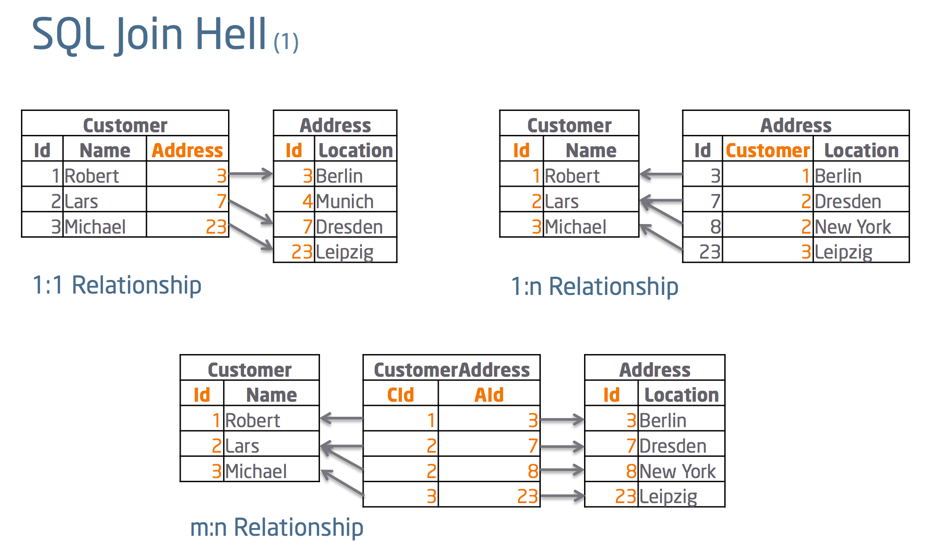
What you (probably) already know:

Slide 29
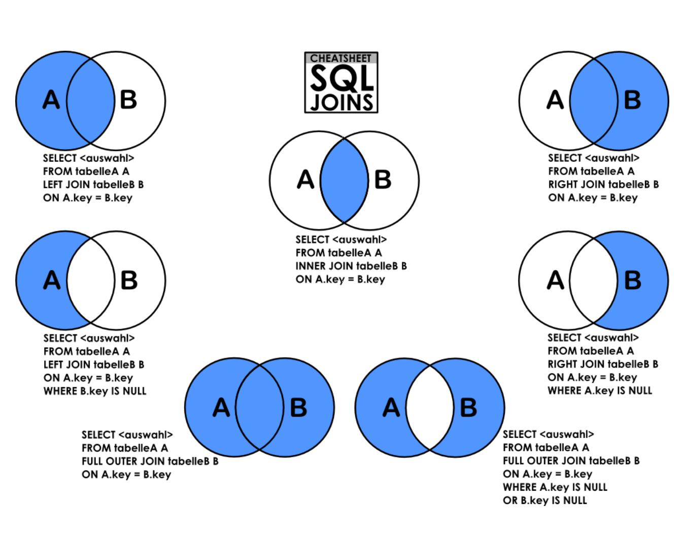

Slide 30

The Problem
Joins are executed every time you query the relationship
1
Executing a Join means to search for a key
2
B-Tree Index: O(log(n))
Your data grows by 10x, your time goes up by one step on each Join
3
4
More Data = More Searches Slower Performance

Slide 31
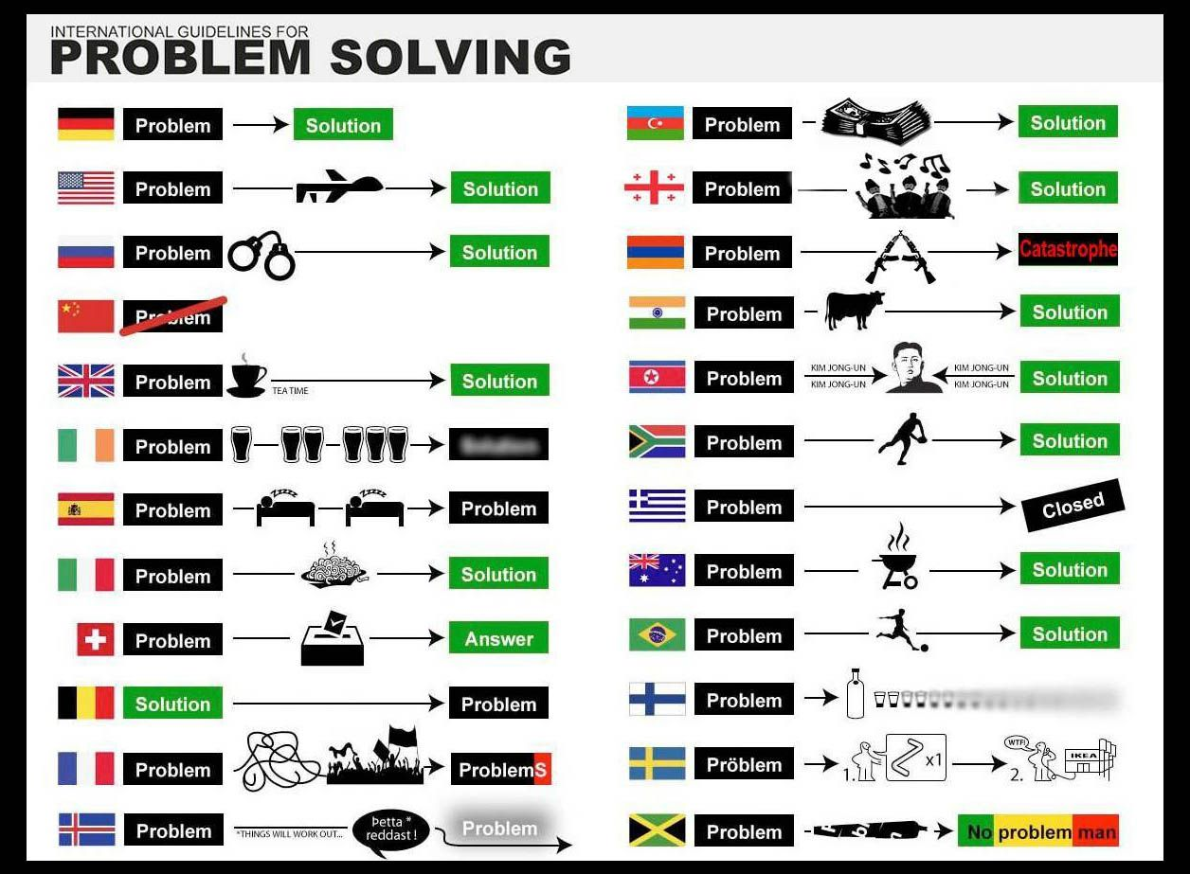

Slide 32
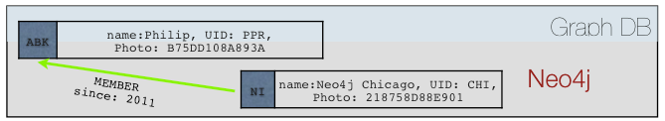
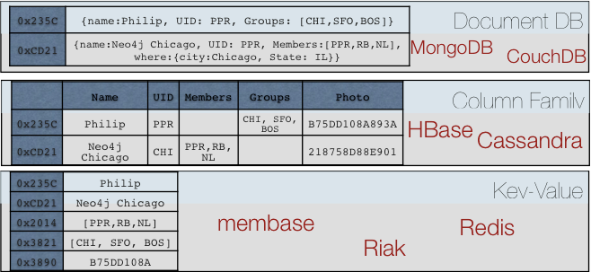
The Solutions: NoSQL Databases
1
Wrong Model
They cannot model or store relationships without complexity
2
Degraded Performance
Speed plummets as you try to join data together in the application
3
Wrong Languages
Lots of wacky “almost sql” languages terrible at “joins”
4
Not ACID
Eventually Consistent means Eventually Corrupt

Slide 33
What does that mean?

Slide 34
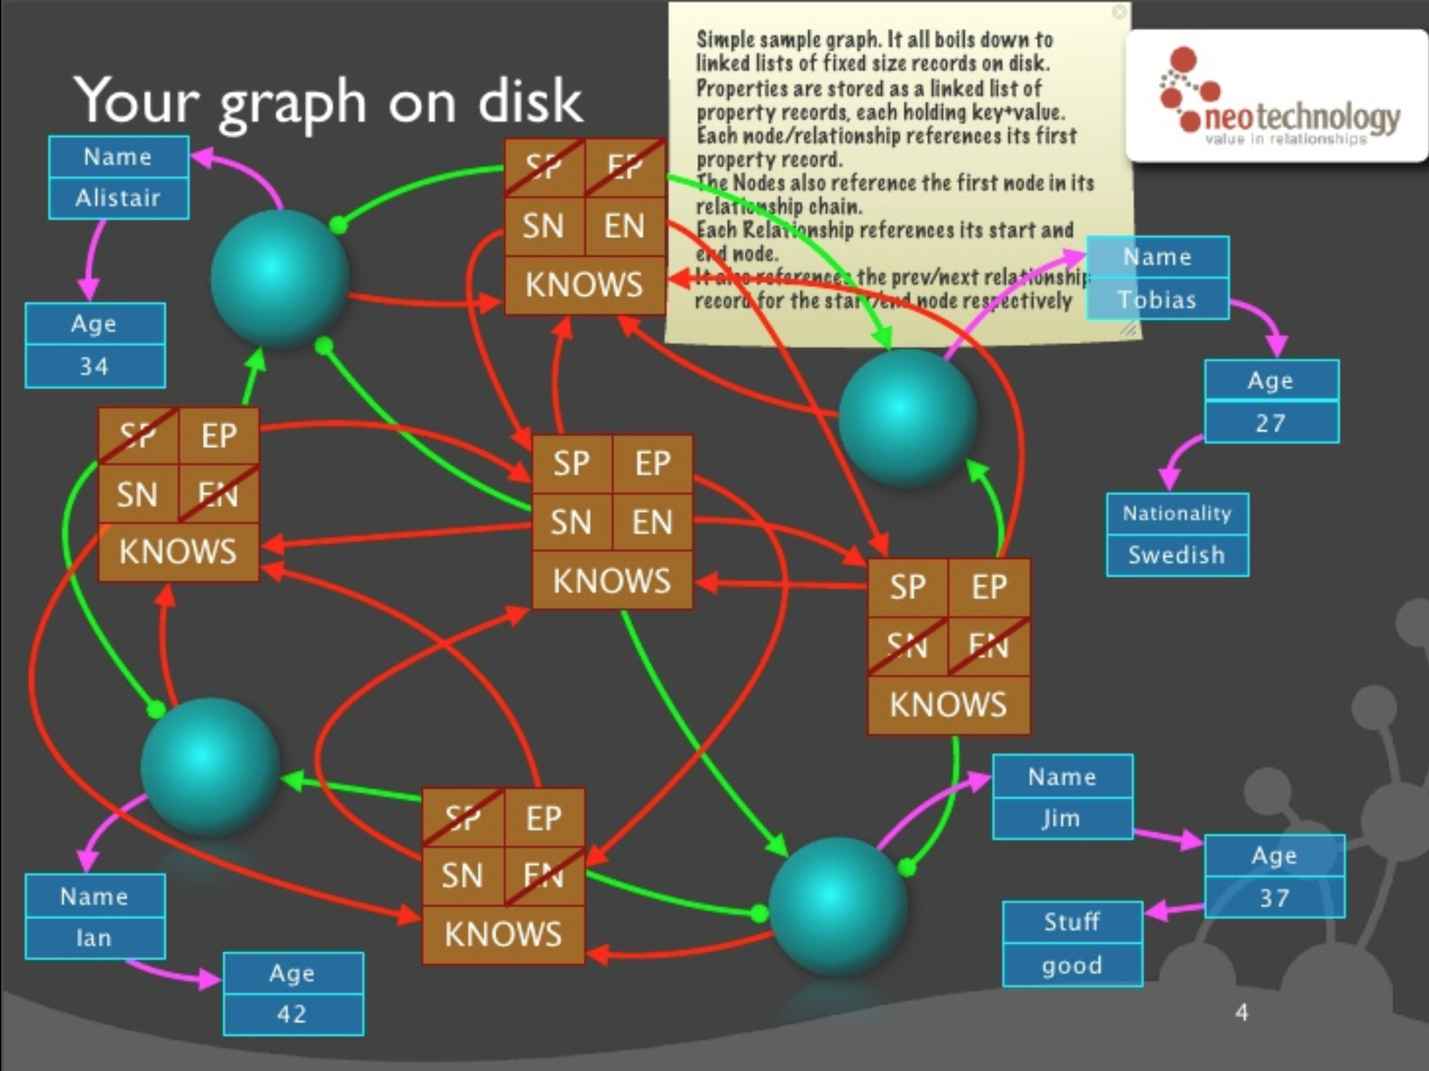
Double Linked List RelationshipS
Single Linked List Property Records

Slide 35
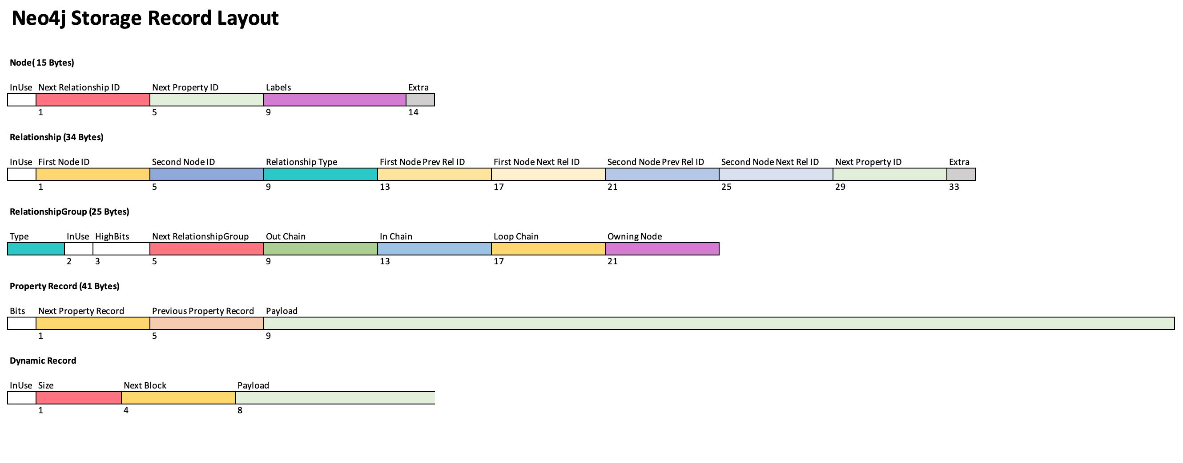
tricky bits
Node and Rels IDs need 34 Bits, not 32.
First Relationship Off each Group Chain hold Counts

Slide 36
That is too complicated, just focus on the next slide

Slide 37
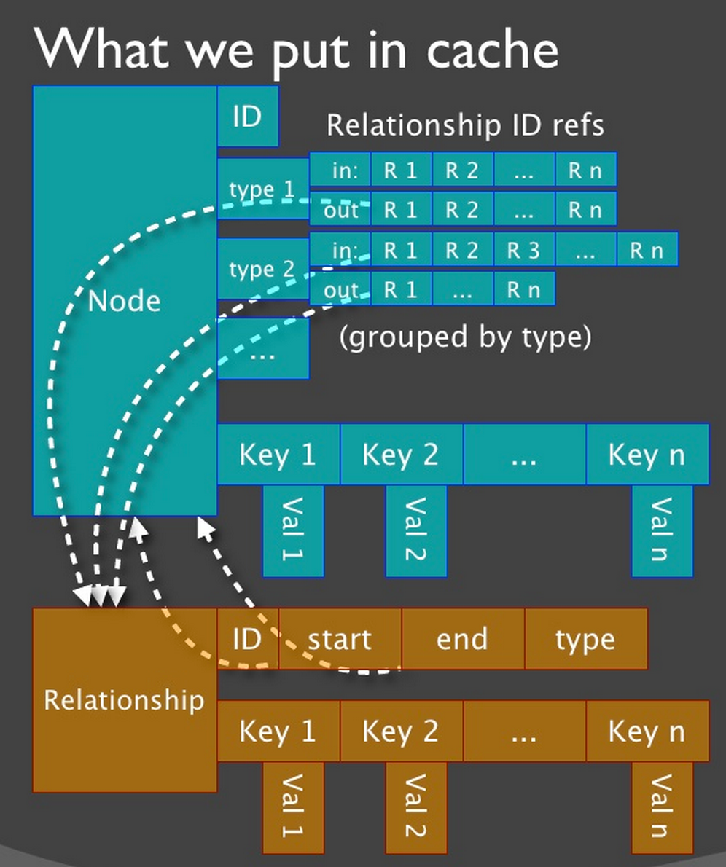
Neo4j Secret Sauce
1
Pointers instead of Lookups
2
Fixed Sized Records
3
“Joins” on Creation
4
Spin Spin Spin through this data structure

Slide 38
Real Time Query Performance
Remains steady as database grows
Relational and Other NoSQL Databases
Neo4j is 1000x faster Reduces minutes to milliseconds
Response Time
Neo4j
0 to 2 hops 0 to 3 degrees Thousands of connections
Tens to hundreds of hops Thousands of degrees Billions of connections
Connectedness and Size of Data Set

Slide 39

But not for every query
I don’t know the average height of all hollywood actors, but I do know the Six Degrees of Kevin Bacon

Slide 40

Graphs are Whiteboard Friendly
Just draw stuff and “walla” there is your data model

Slide 41

BullShit
Unless you want to go slow…

Slide 42
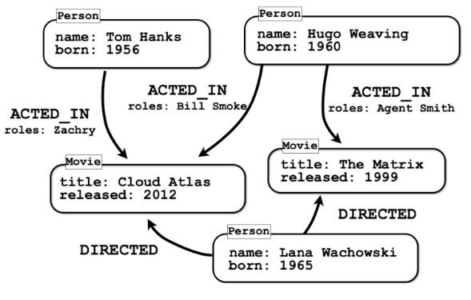
Some Models are Easy
Movie Property Graph

Slide 43


Slide 44
Some Models are Easy but not for all Questions
Should Roles be their own Node?

Slide 45

How do you model Flight Data?

Slide 46
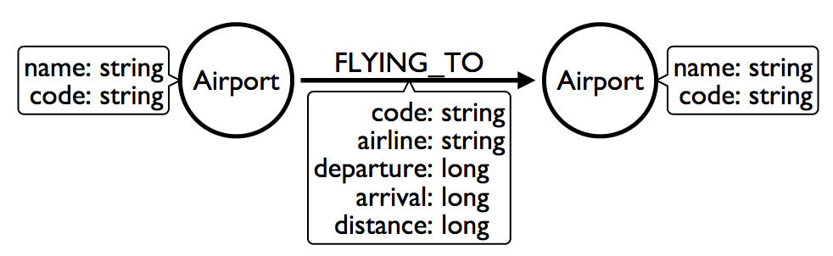
How do you model Flight Data?
Airports Nodes with Flying To Relationships

Slide 47
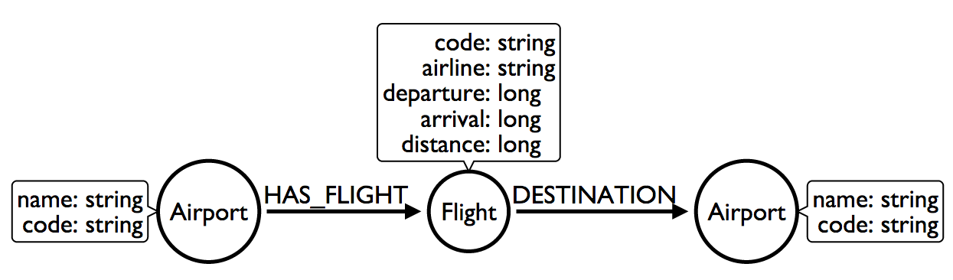
How do you model Flight Data?
Maybe Flight should be its own Node?

Slide 48
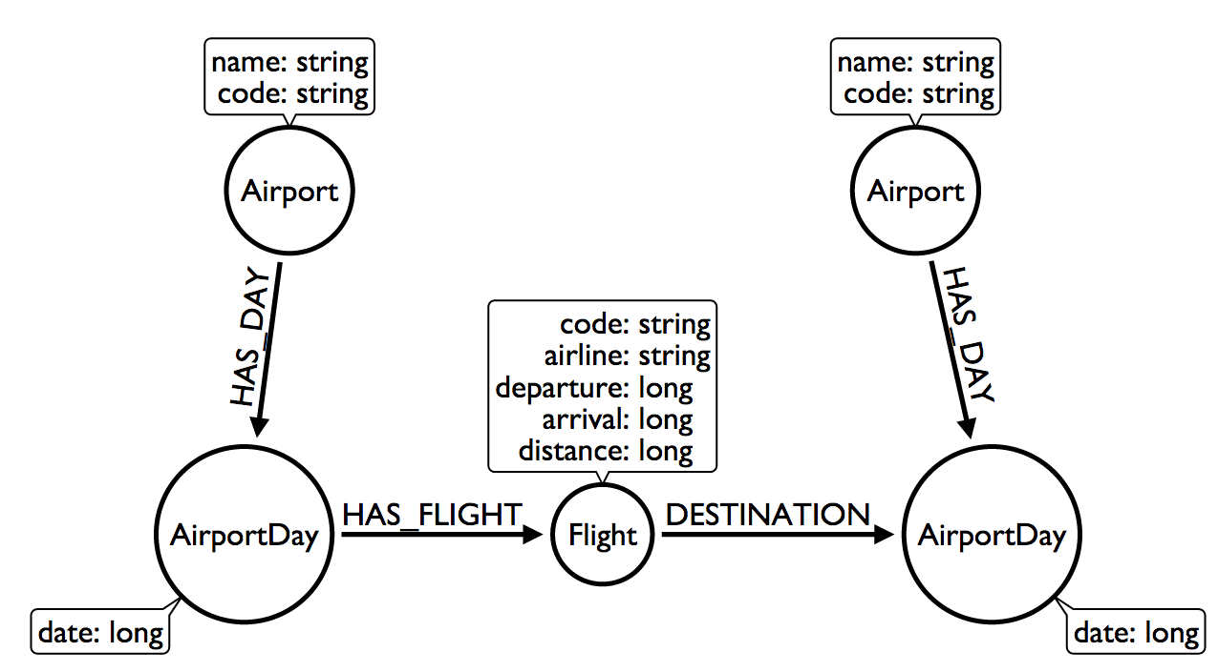
How do you model Flight Data?
Don’t we care about Flights only on particular Days?

Slide 49
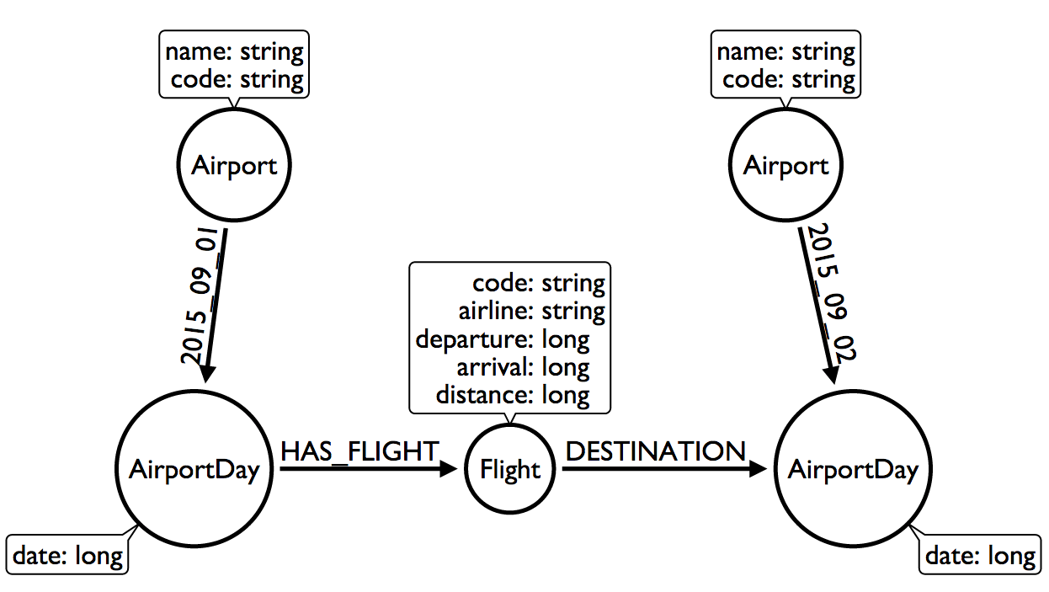
How do you model Flight Data?
What is this trick with the date in the relationship type?

Slide 50
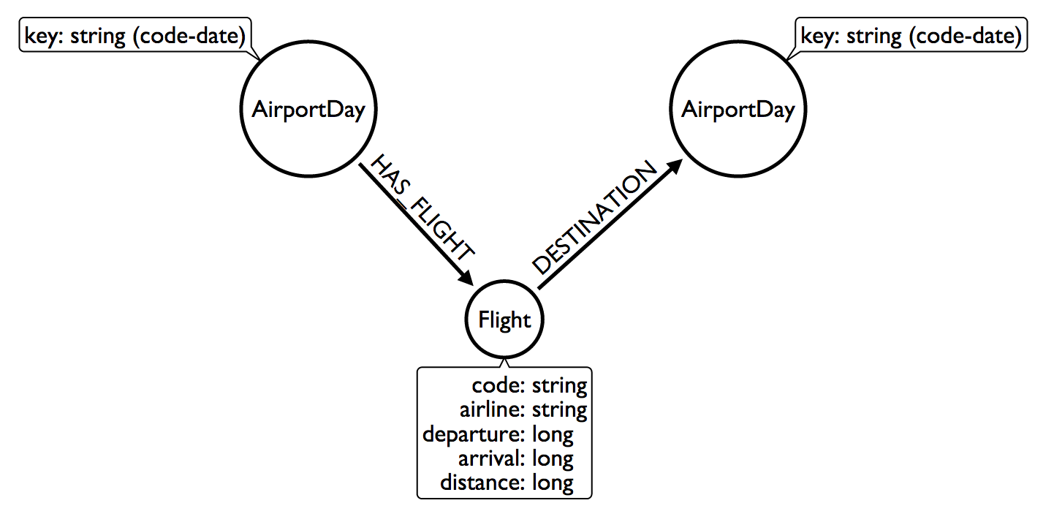
How do you model Flight Data?
We don’t need Airports if we model this way!

Slide 51

Lets get Creative

Slide 52
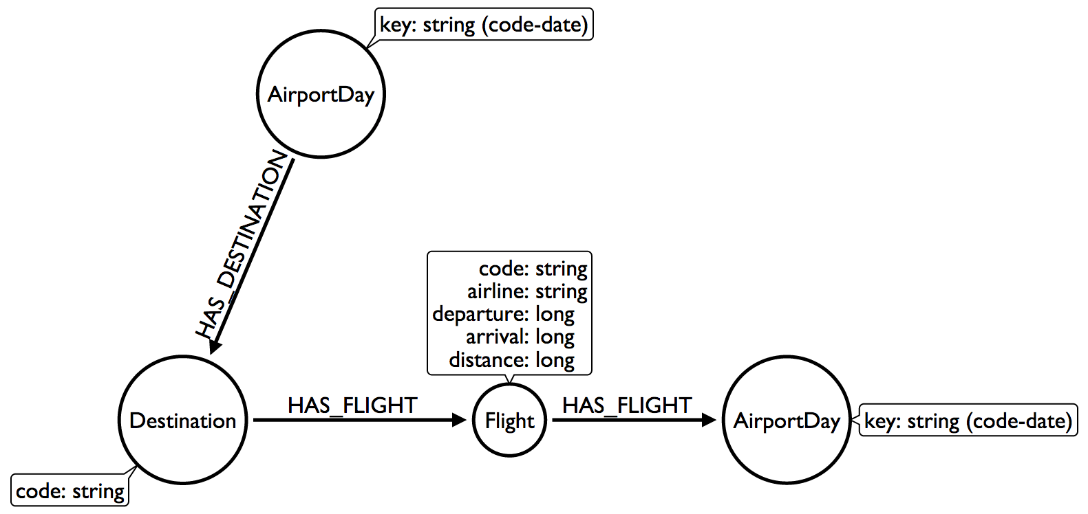
How do you model Flight Data?
Group Destinations together!

Slide 53
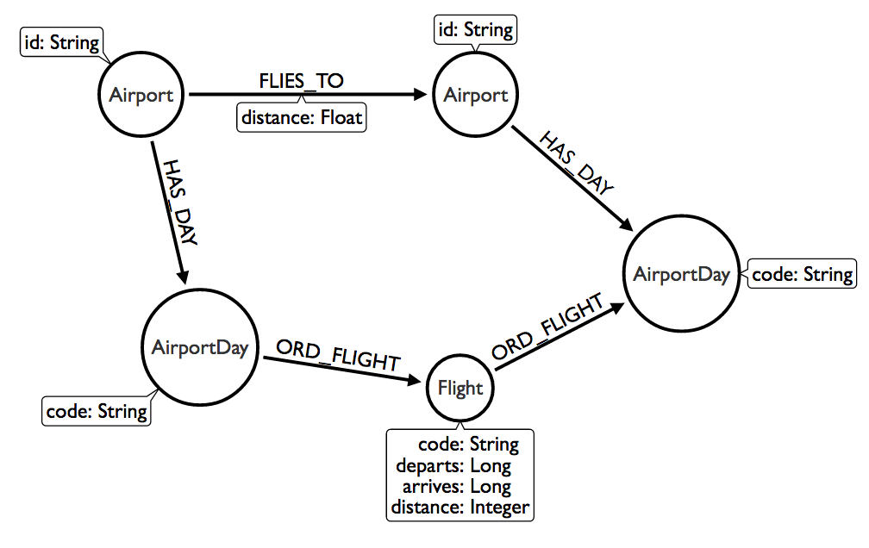
How do you model Flight Data?
OMG WAT!

Slide 54
Neo4j Secret Sauce Again
1
Pointers instead of Lookups
2
Fixed Sized Records
3
“Joins” on Creation
4
Spin Spin Spin through this data structure

Slide 55

Do not try and bend the data. That’s im possible.

Slide 56

How do you model Comic Books?
If they can do it, you can do it!

Slide 57

Cloning Twitter
How do others do it?

Slide 58
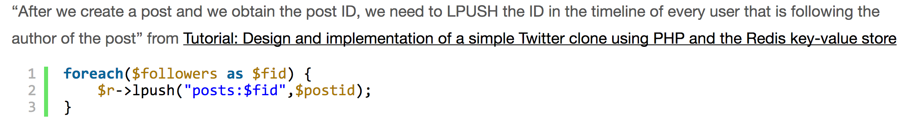
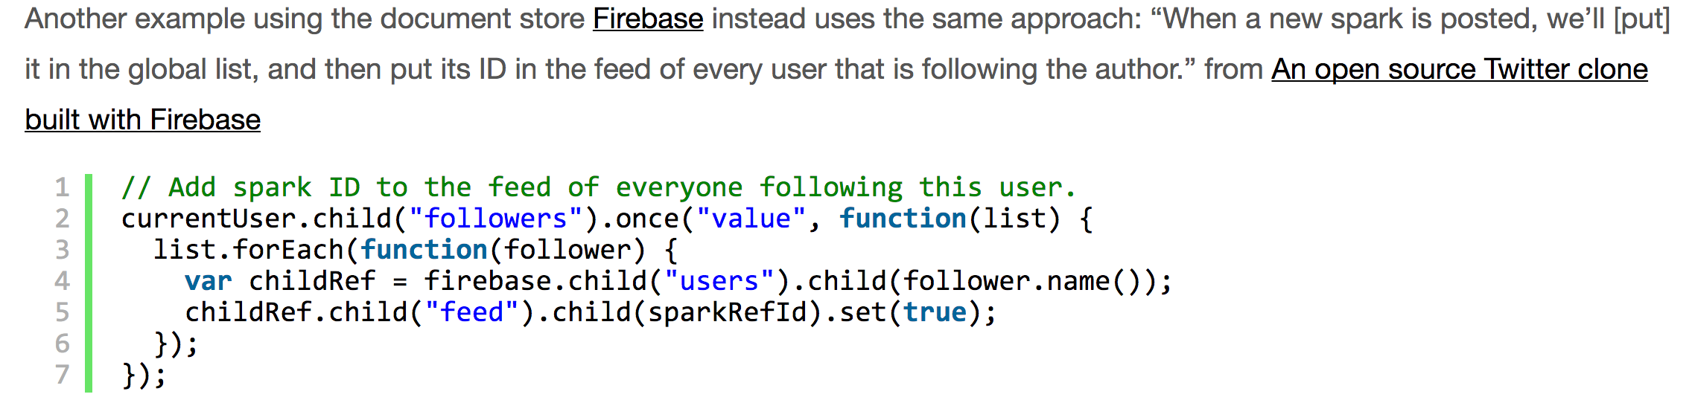
Cloning Twitter
How do others do it?

Slide 59
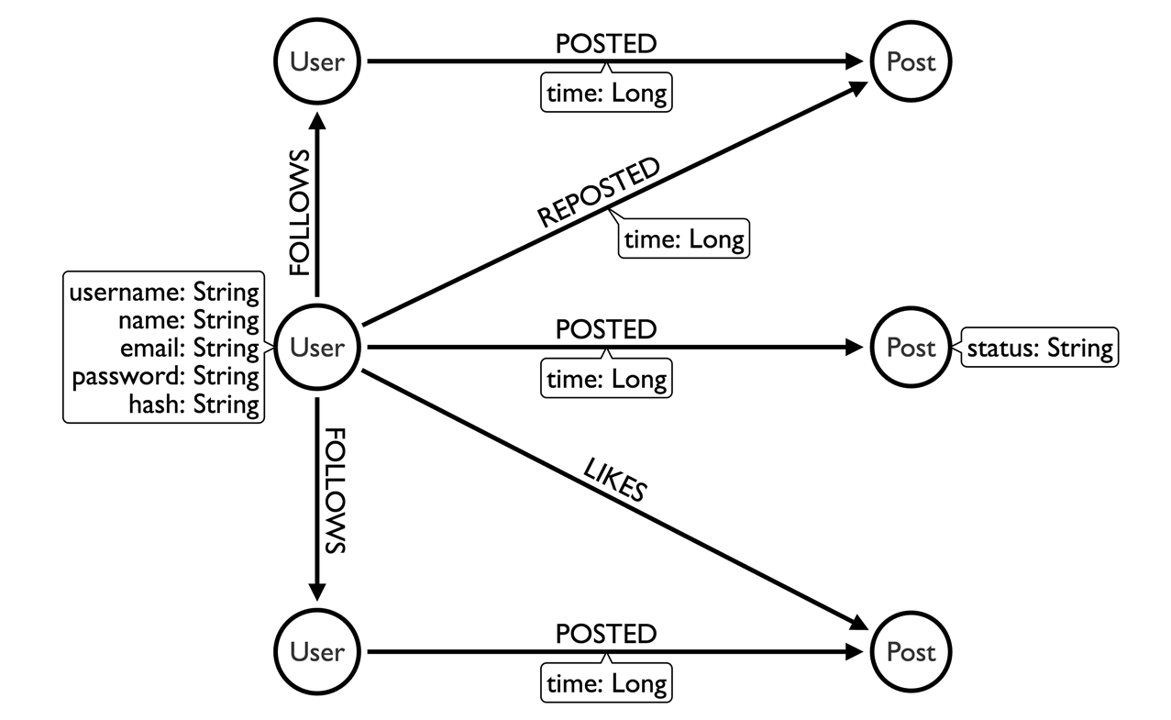
Modeling a Twitter Feed
The Wrong Way

Slide 60
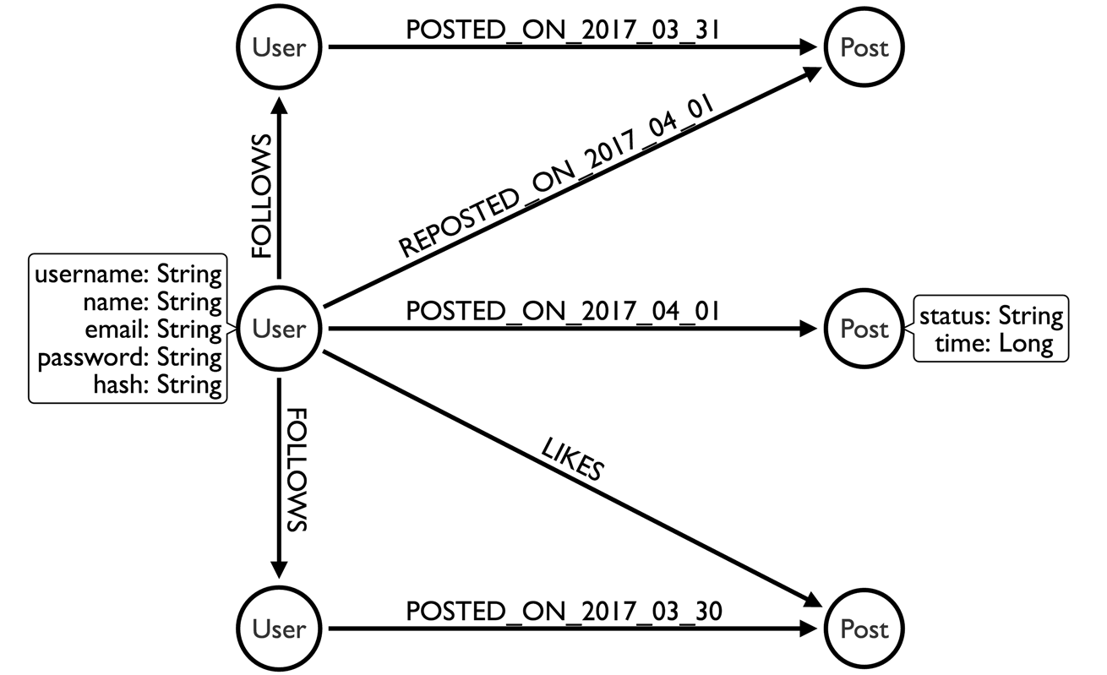
Modeling a Twitter Feed
A Better Way

Slide 61
Neo4j Secret Sauce Yet Again
1
Pointers instead of Lookups
2
Fixed Sized Records
3
“Joins” on Creation
4
Spin Spin Spin through this data structure

Slide 62

Make the Queries Scale
…and the database scales with them.
…and that’s why we don’t make any money.

Slide 63

Scaling out
is in fashion
But when your model and your query match you don’t have to.

Slide 64
Stored Procedures
First time with IntelliJ, starting a Stored Procedure

Slide 65

Rules for Stored Procedures
Can you get away with it in Cypher?
Is it already in APOC?
Has one of us already done it?
Ok fine, I’ll write it.

Slide 66
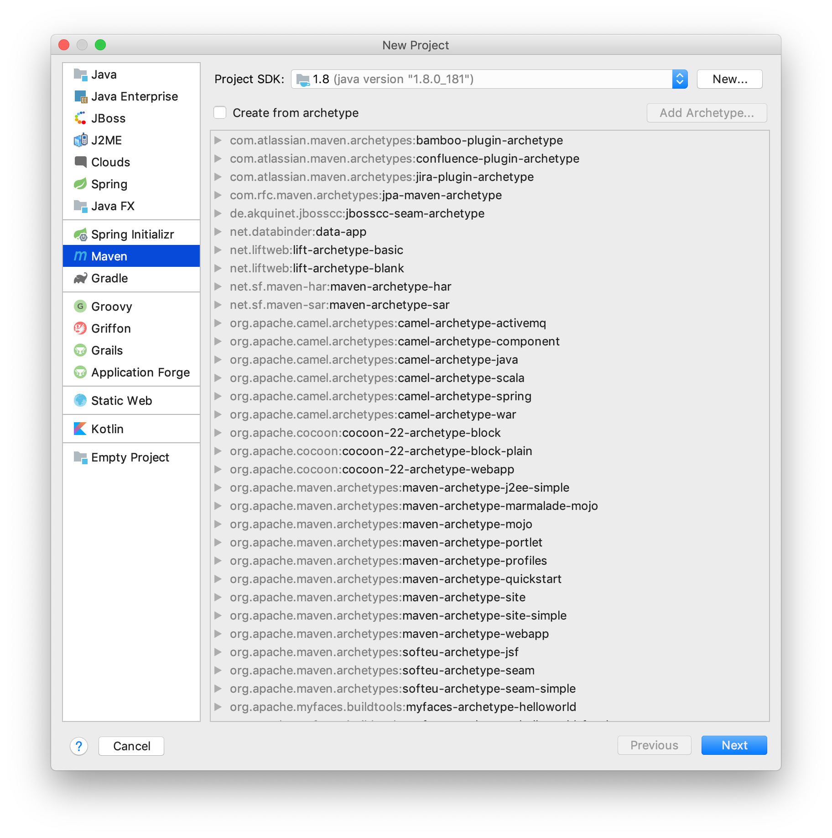
Let’s go
Start a New Project in IntelliJ Choose Maven option.
If the option is not there install maven plugin and restart IntelliJ.

Slide 67
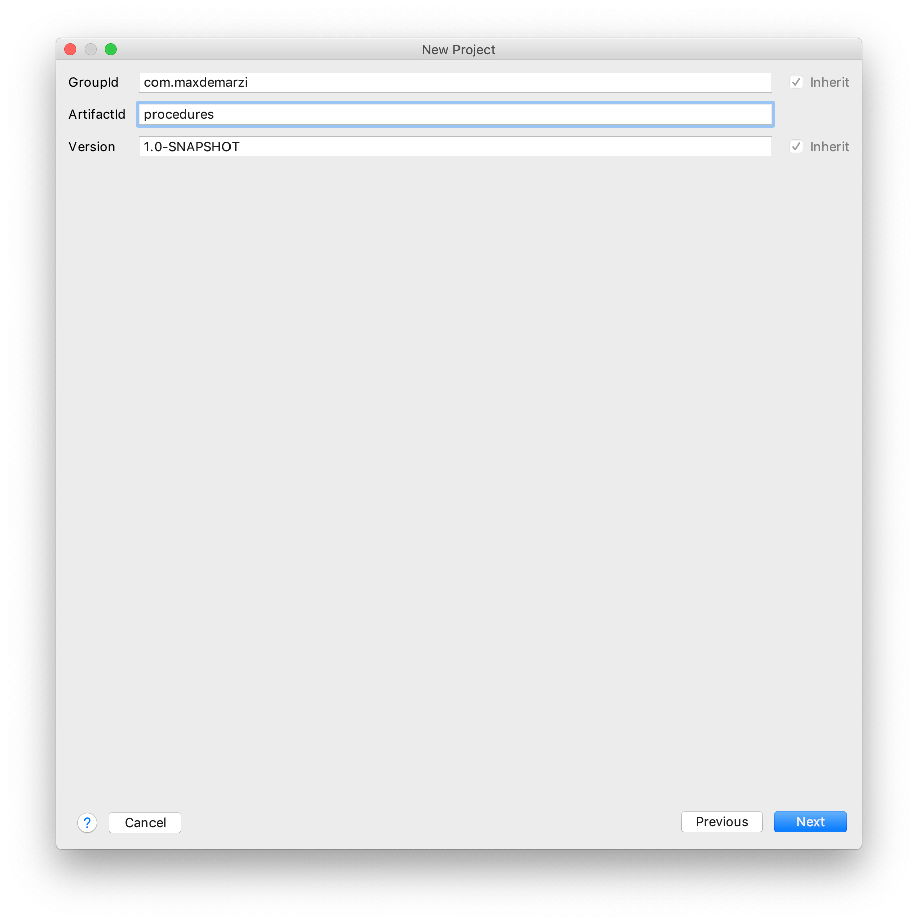
Name it
Use com.yourname for the GroupId and “procedures” for the ArtifactId.

Slide 68
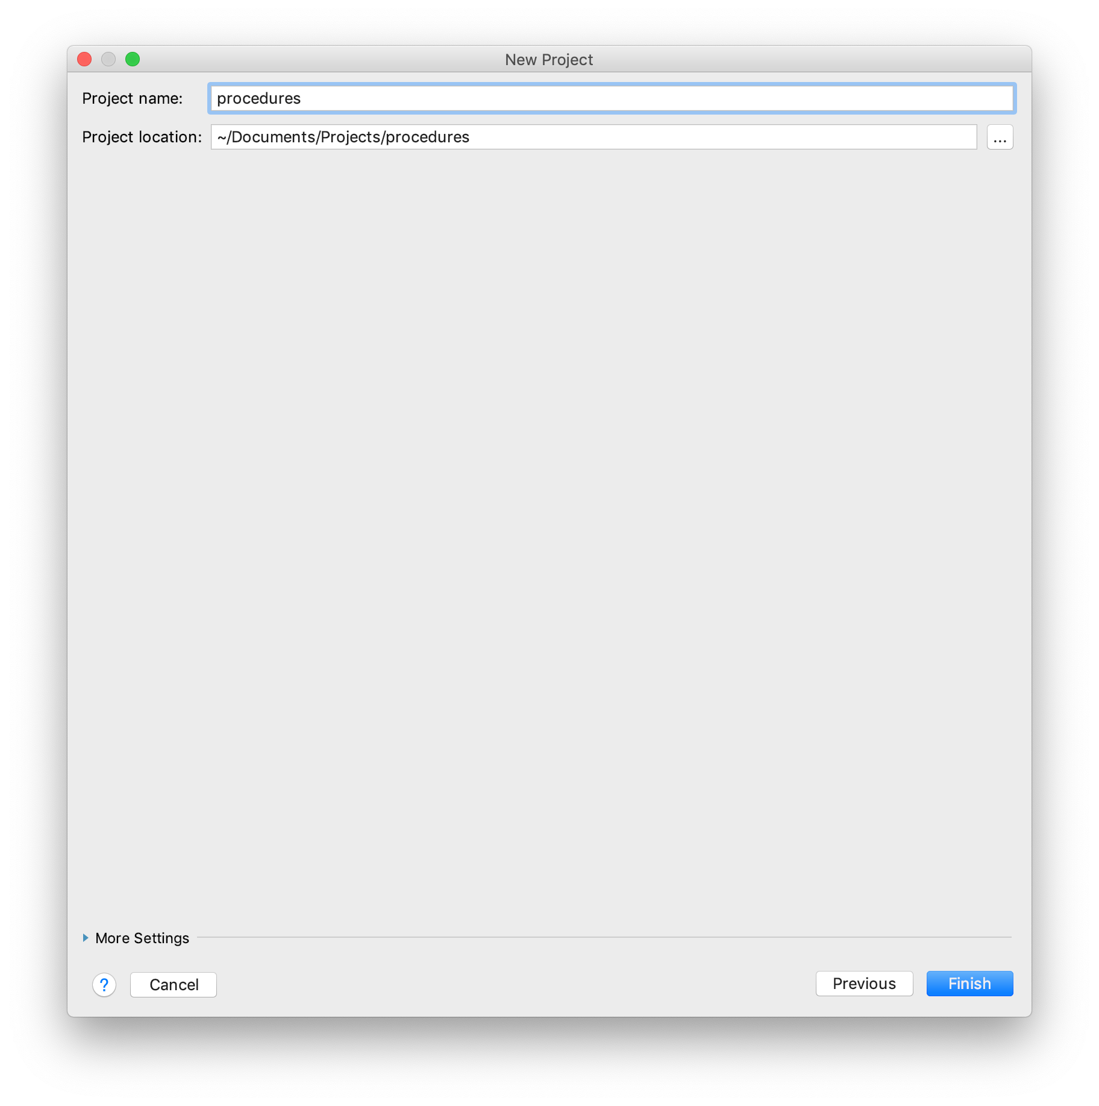
Pick a location
Anywhere will do.

Slide 69
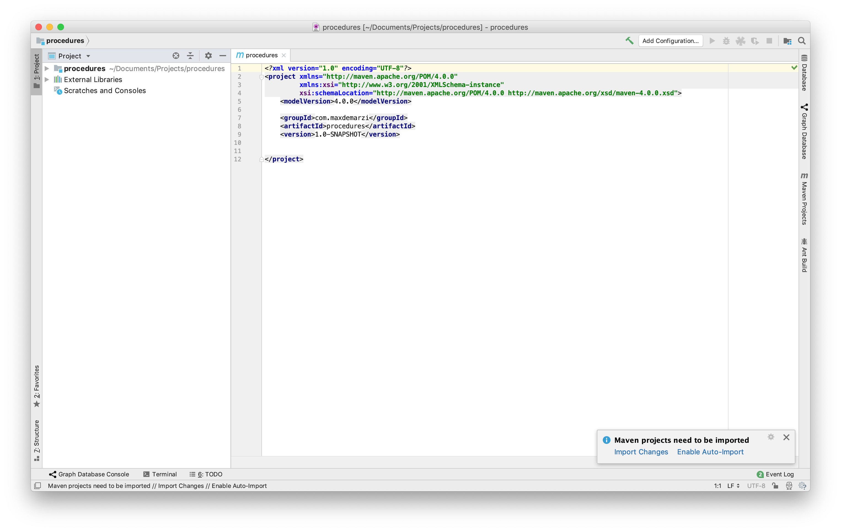
Alright Alright Alright
Enable Auto-Import

Slide 70
Put some Properties in there
<properties>
<neo4j.version>3.5.1</neo4j.version>
<neo4j.driver.version>1.7.2</neo4j.driver.version>
<project.build.sourceEncoding>UTF-8</project.build.sourceEncoding>
</properties>

Slide 71
Dependencies
<dependencies>
<dependency>
<groupId>org.neo4j</groupId>
<artifactId>neo4j</artifactId>
<version>${neo4j.version}</version>
<scope>provided</scope>
</dependency>
<!-- This gives us the Procedure API our runtime code uses.
We have a `provided` scope on it, because when this is
deployed in a Neo4j Instance, the API will be provided
by Neo4j. If you add non-Neo4j dependencies to this
project, their scope should normally be `compile` -->

Slide 72
Test Dependencies
<dependency>
<groupId>org.neo4j.test</groupId>
<artifactId>neo4j-harness</artifactId>
<version>${neo4j.version}</version>
<scope>test</scope>
</dependency>
<!-- This is used for a utility that
lets us start Neo4j with a specific Procedure, which is nice for writing tests. -->

Slide 73
Test Dependencies
<dependency>
<groupId>org.neo4j.driver</groupId>
<artifactId>neo4j-java-driver</artifactId>
<version>${neo4j.driver.version}</version>
<scope>test</scope>
</dependency>
<!-- Used to send cypher statements to our procedure. -->

Slide 74
JUnit Dependencies
<dependency>
<groupId>junit</groupId>
<artifactId>junit</artifactId>
<version>4.12</version>
<scope>test</scope>
</dependency>
</dependencies>
<!-- It’s been 4.12 for like 4 years, but 4.13 is on the way. -->

Slide 75
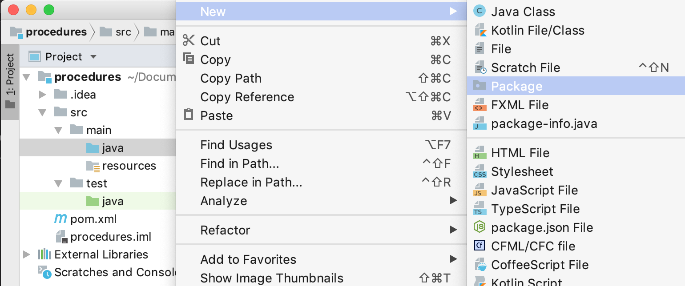
Add a new Package
Make sure you are on the Java Directory and Right Click.

Slide 76
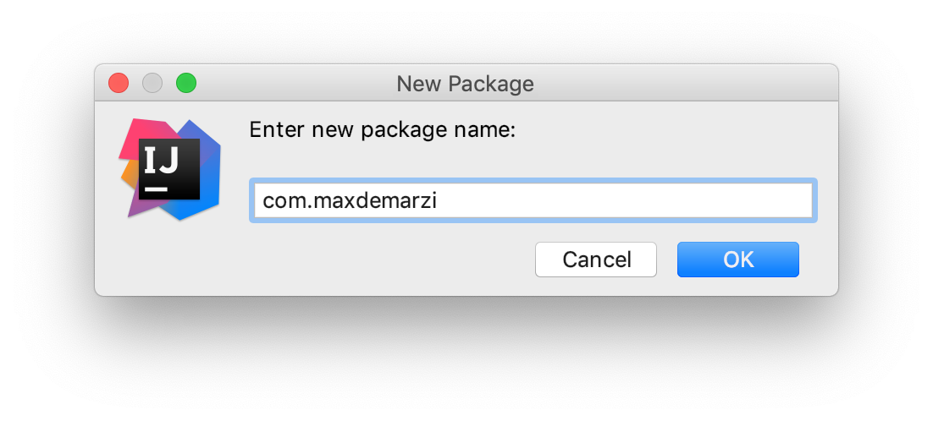
Use com.your name again
Expand the Java directory and it will be there now.

Slide 77
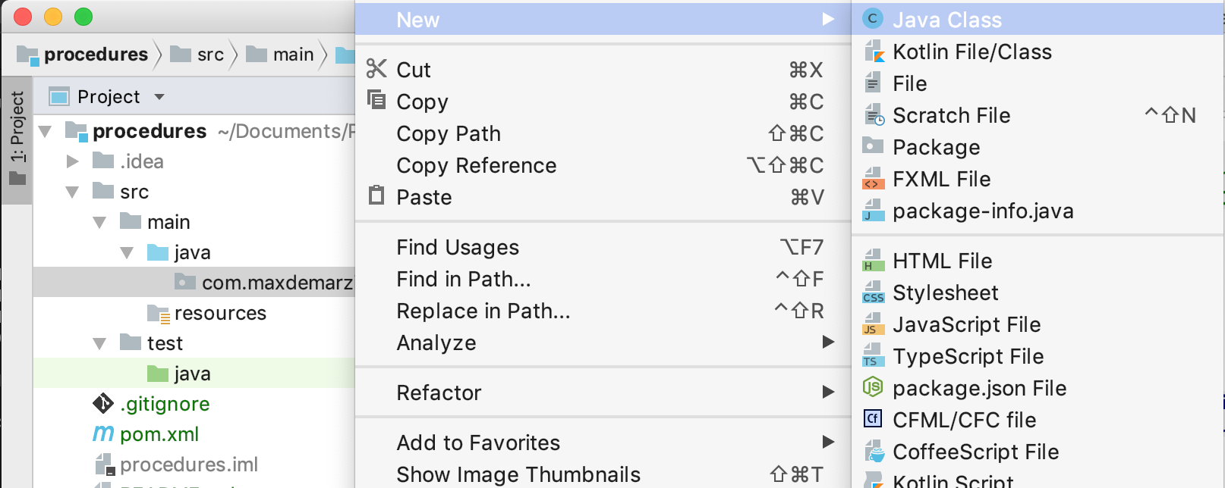
Add a new Java Class
Make sure you are on your Package folder and Right-Click.

Slide 78
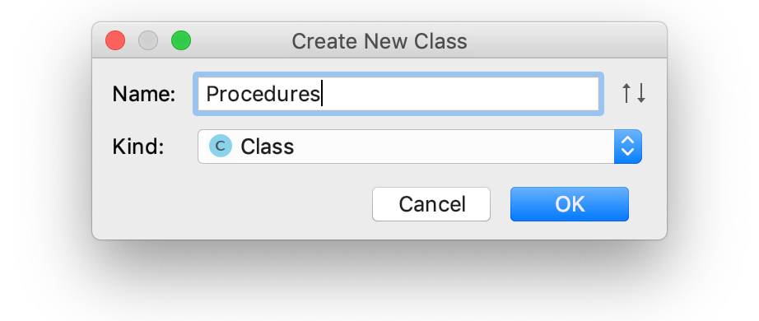
Name it Procedures
You can call it whatever you want, but stick with me here.

Slide 79
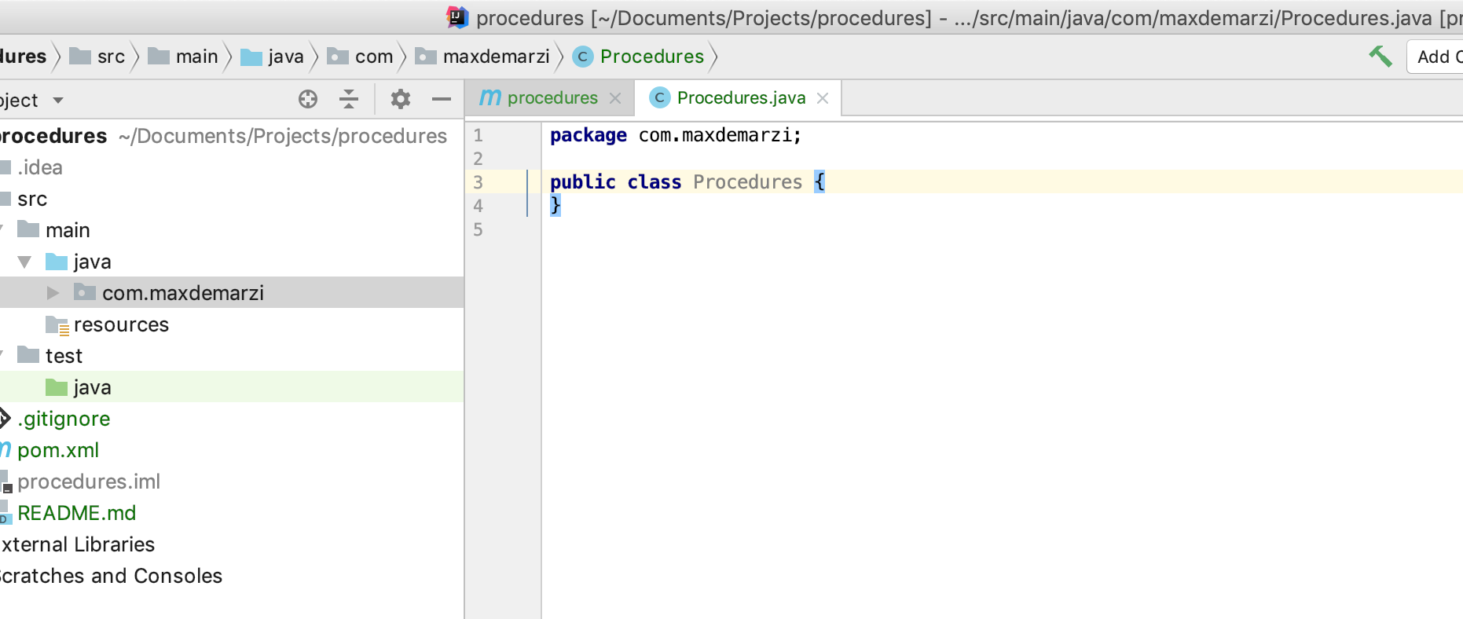
You should see this
If not you messed up somewhere.

Slide 80
// This field declares that we need a GraphDatabaseService
// as context when any procedure in this class is invoked
@Context
public GraphDatabaseService db;
// This gives us a log instance that outputs messages to the
// standard log, normally found under `data/log/console.log`
@Context
public Log log;

Slide 81
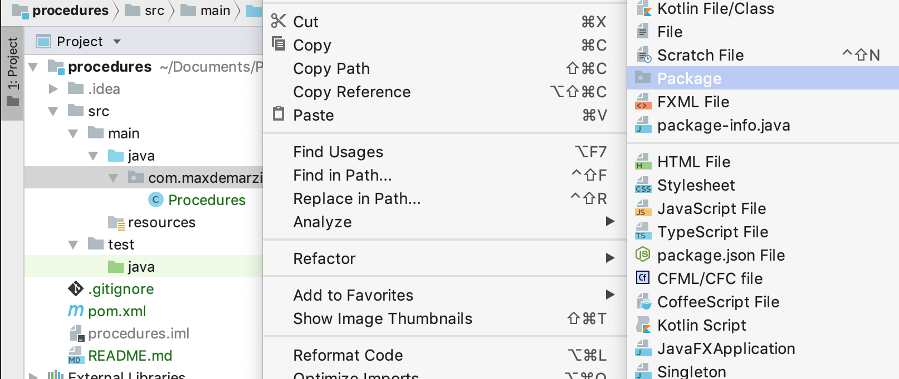
Add a new Package
Make sure you are on the Java Directory and Right Click.

Slide 82
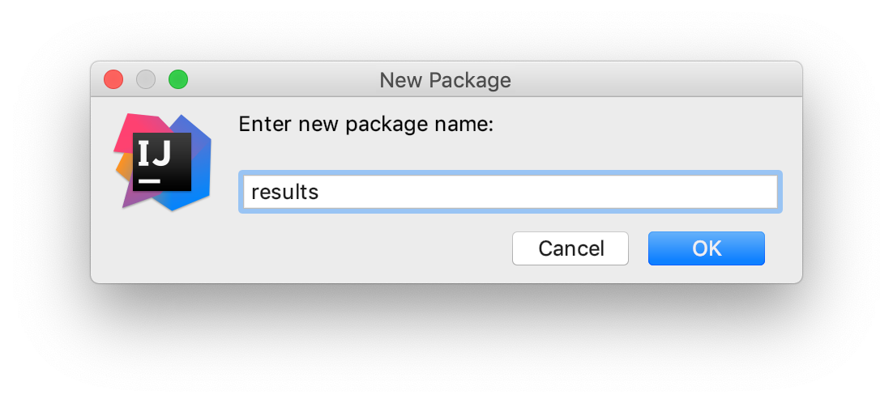
name it results
You can organize your stored procedure any way you want, but today you do it this way.

Slide 83
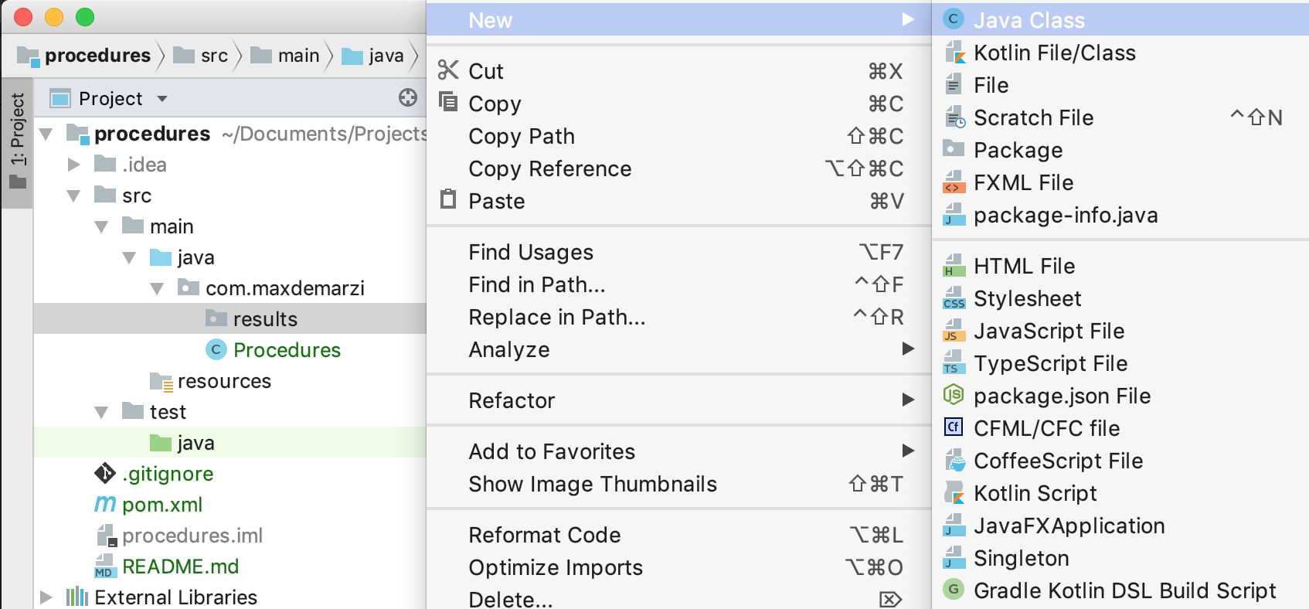
Add a new Java Class
Make sure you are on your results folder and Right-Click.

Slide 84
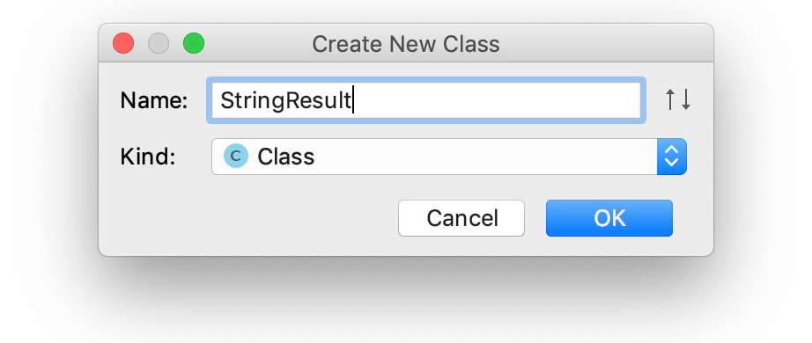
Name it StringResult
This will be used to return String results… who would have thought.

Slide 85
public class StringResult {
public final static StringResult EMPTY = new StringResult(null);
public final String value;
public StringResult(String value) {
this.value = value;
}
}

Slide 86
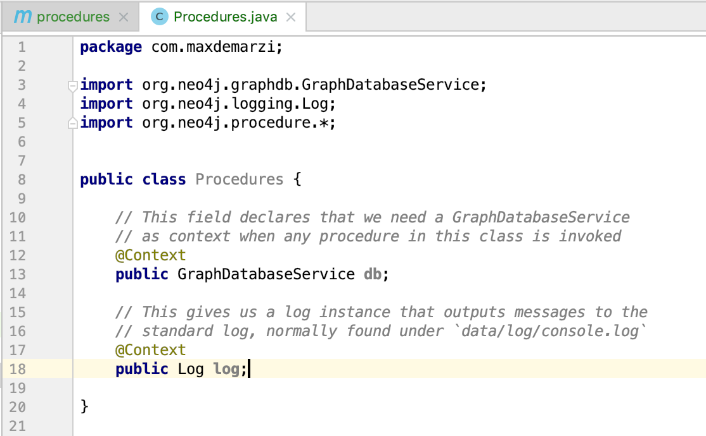
Back to Procedures
Let’s make an “Echo” procedure.

Slide 87
@Procedure(name = "com.maxdemarzi.echo", mode = Mode.READ)
@Description("CALL com.maxdemarzi.echo(String said)")
public Stream<StringResult> echo(@Name("said") String said) {
return Stream.of(new StringResult(said));
}

Slide 88
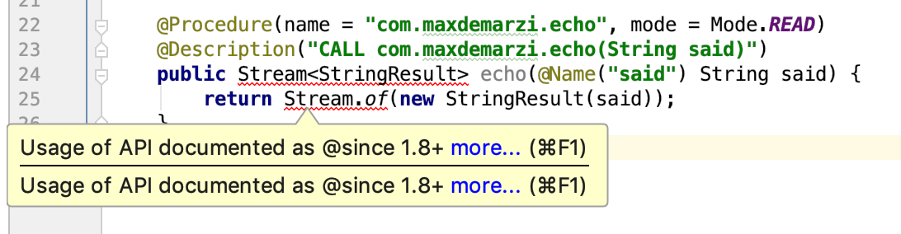
Something is wrong
Red Squiggles means you done messed up.

Slide 89
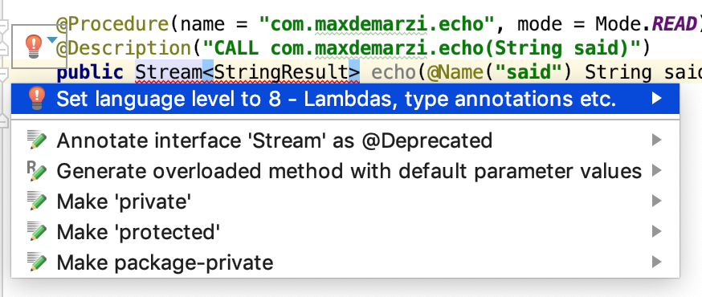
Set language level to 8
Click on red light bulb, set it.

Slide 90
<build>
<plugins>
<plugin>
<groupId>org.apache.maven.plugins</groupId>
<artifactId>maven-compiler-plugin</artifactId>
<configuration>
<source>8</source>
<target>8</target>
</configuration>
</plugin>
</plugins>
</build>

Slide 91

Shade
Let’s add one more Plugin

Slide 92
Shade Plugin
<plugin>
<artifactId>maven-shade-plugin</artifactId>
<version>3.2.1</version>
<executions>
<execution>
<phase>package</phase>
<goals>
<goal>shade</goal>
</goals>
</execution>
</executions>
</plugin>
<!-- This generates a fat jar-file with our procedure code, plus any dependencies marked as `compile` scope.
This should then be deployed in the `plugins` directory of each Neo4j instance in your deployment.
After a restart, the procedure is available for calling. -->

Slide 93
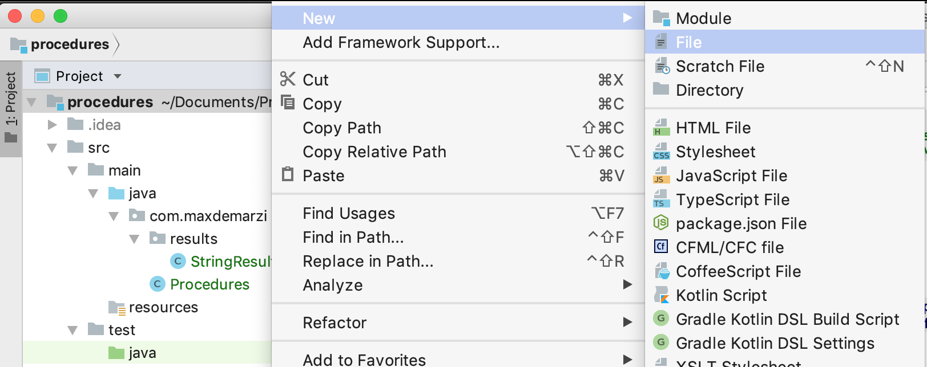
Add a new File
Make sure you are on the TOP level folder, and right-click.

Slide 94
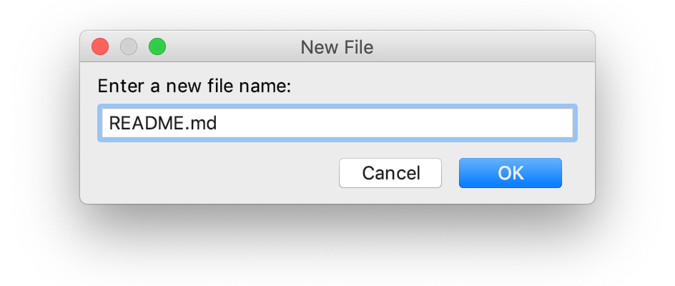
Name it readme.md
This is where your instructions go.

Slide 95
# Procedures
Instructions
------------
This project uses maven, to build a jar-file with the procedure in this
project, simply package the project with maven:
mvn clean package
This will produce a jar-file, `target/procedures-1.0-SNAPSHOT.jar`,
that can be copied to the `plugin` directory of your Neo4j instance.
cp target/procedures-1.0-SNAPSHOT.jar neo4j-enterprise-3.5.1/plugins/.
Restart your Neo4j Server. Your new Stored Procedures are available:

Slide 96
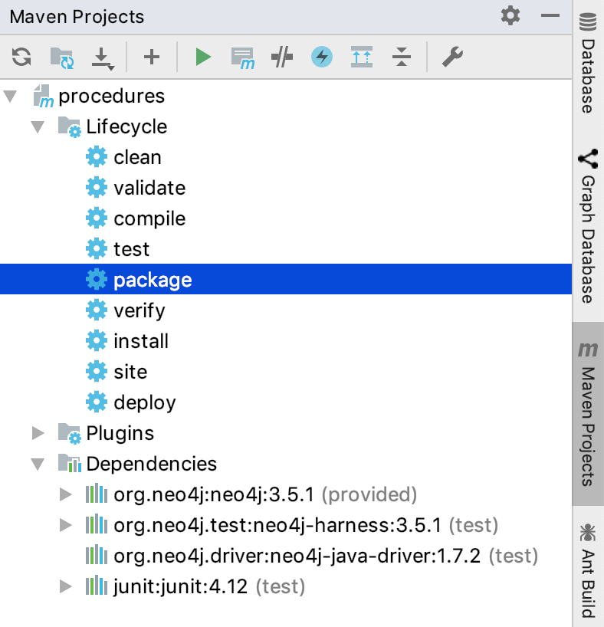
Package it
Find the “Maven Projects” side tab, expand “Lifecyle”, double click on “package”.

Slide 97
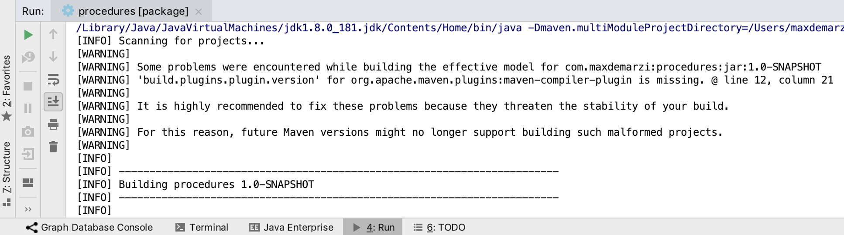
Warning
That’s annoying. Get rid of it by adding a version to the plugin.

Slide 98
<build>
<plugins>
<plugin>
<groupId>org.apache.maven.plugins</groupId>
<artifactId>maven-compiler-plugin</artifactId>
<version>3.8.0</version>
<configuration>
<source>8</source>
<target>8</target>
</configuration>
</plugin>
</plugins>
</build>

Slide 99
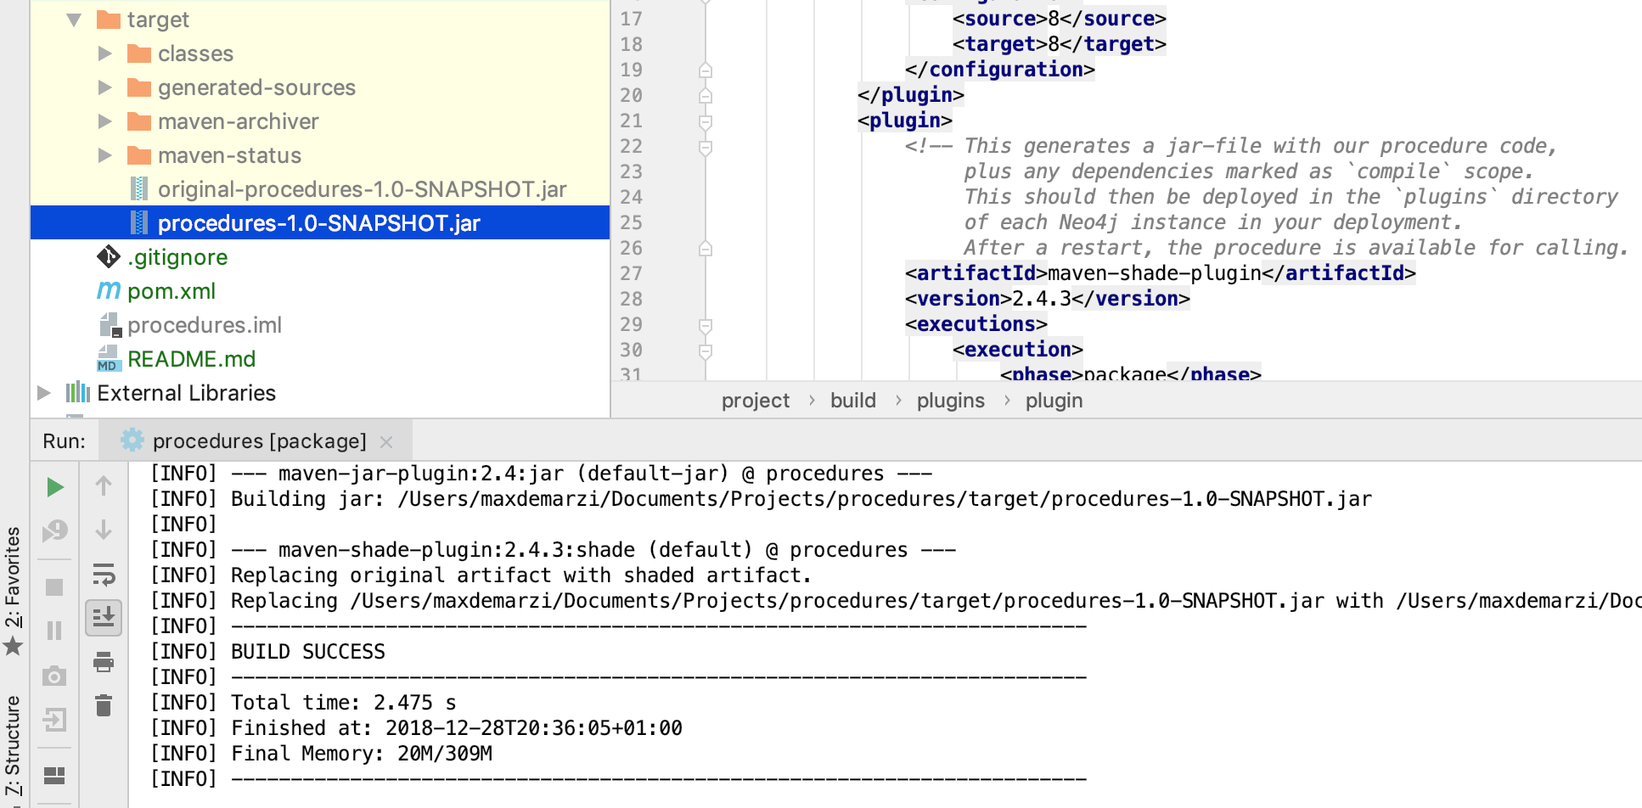
Still worked
Maybe?

Slide 100
Download Neo4j 3.5.1 Server edition
Go to the website: neo4j.com
Click Download
Click Download Neo4j Server
Download 3.5.1 tar or zip file

Slide 101
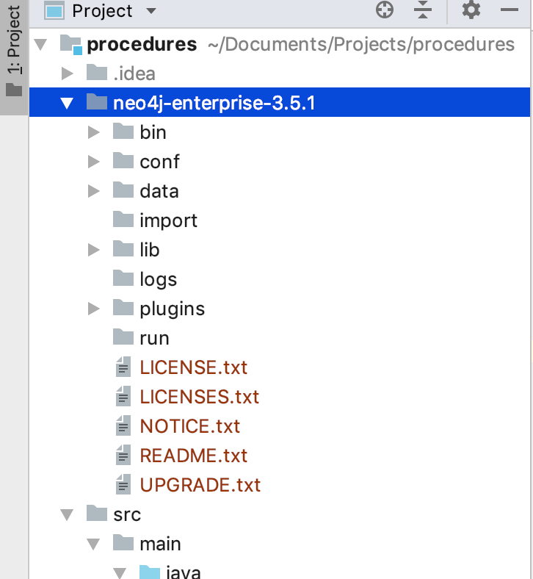
Uncompress it
Put the server version uncompressed in your top level “procedures” directory so it looks like this.

Slide 102
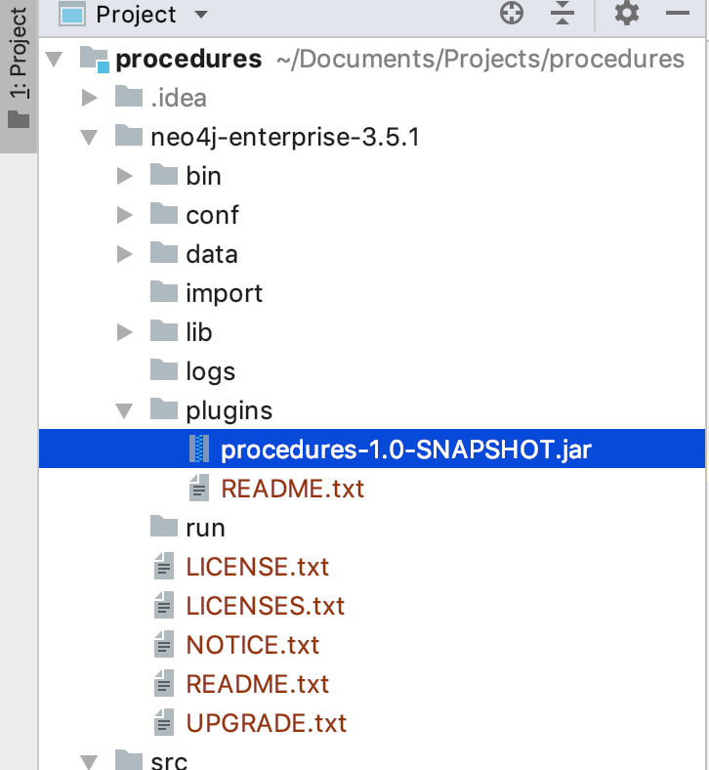
Copy it
Into your plugins folder.
Just like the README.md said.

Slide 103
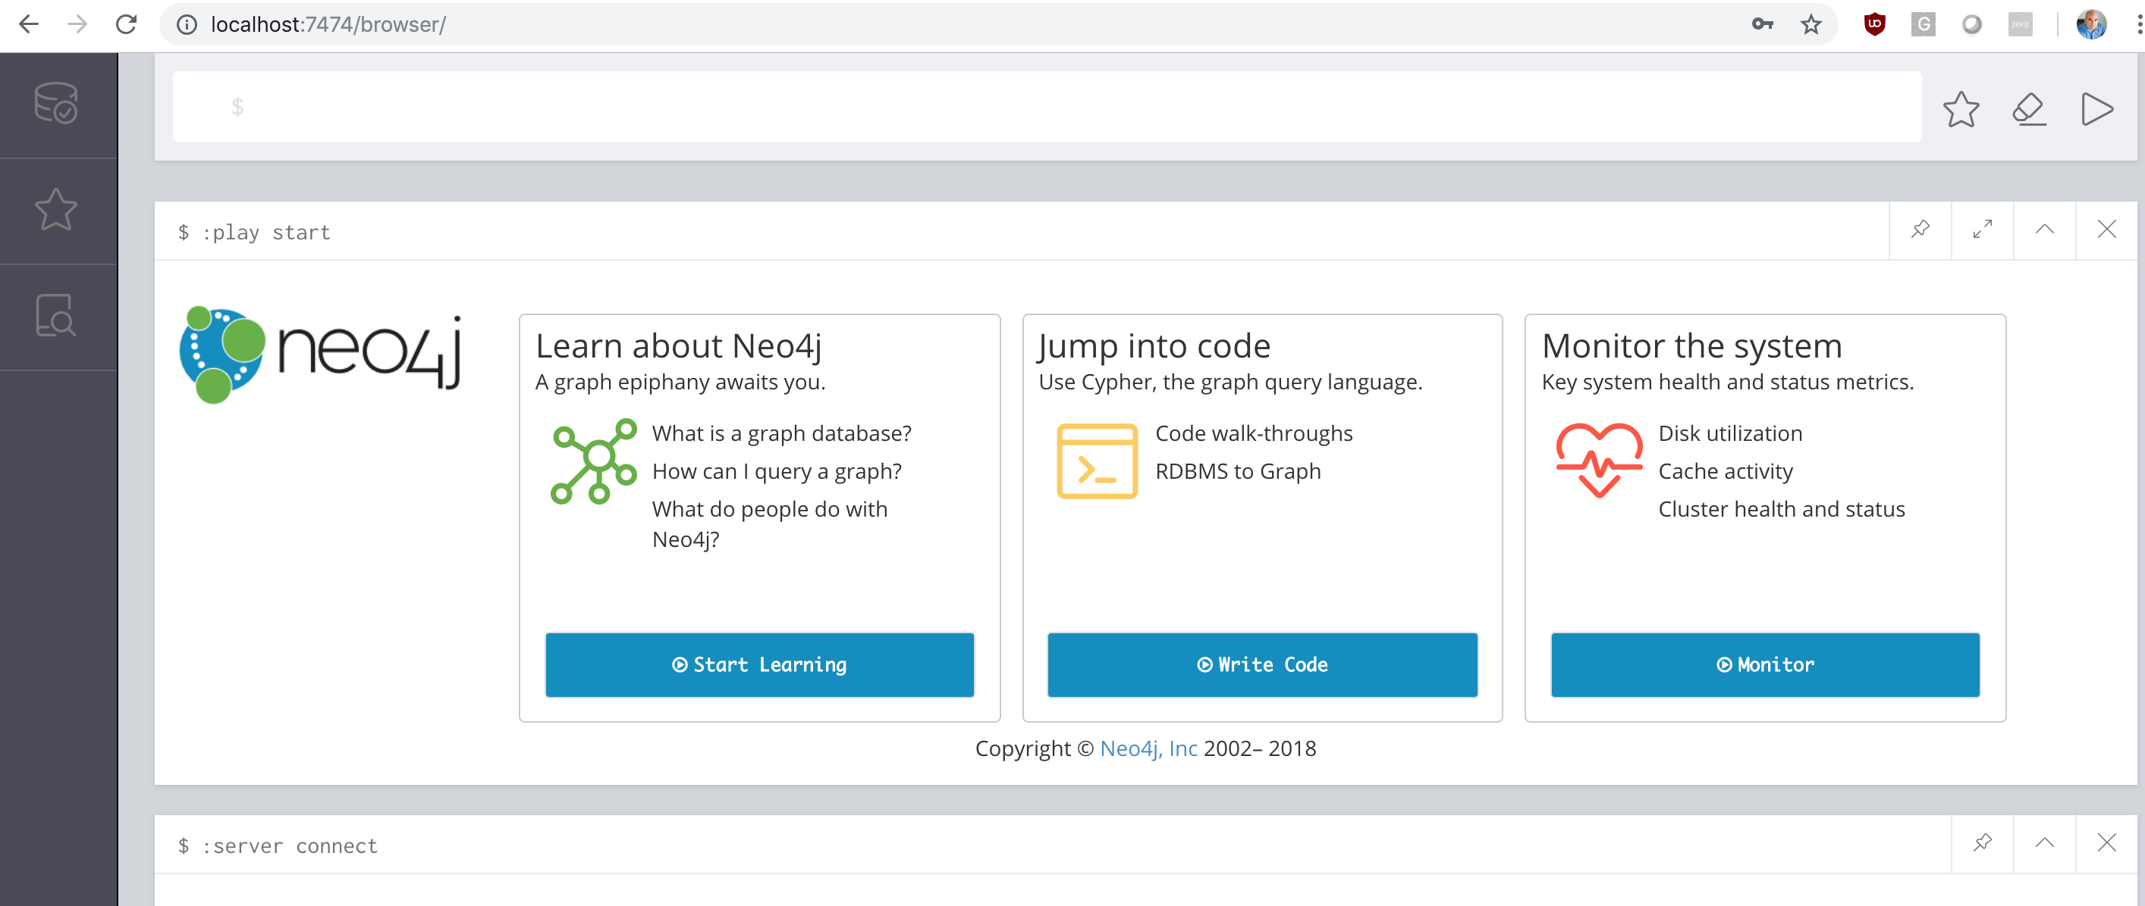
Start Neo4j
Set the initial password and all that jazz.

Slide 104
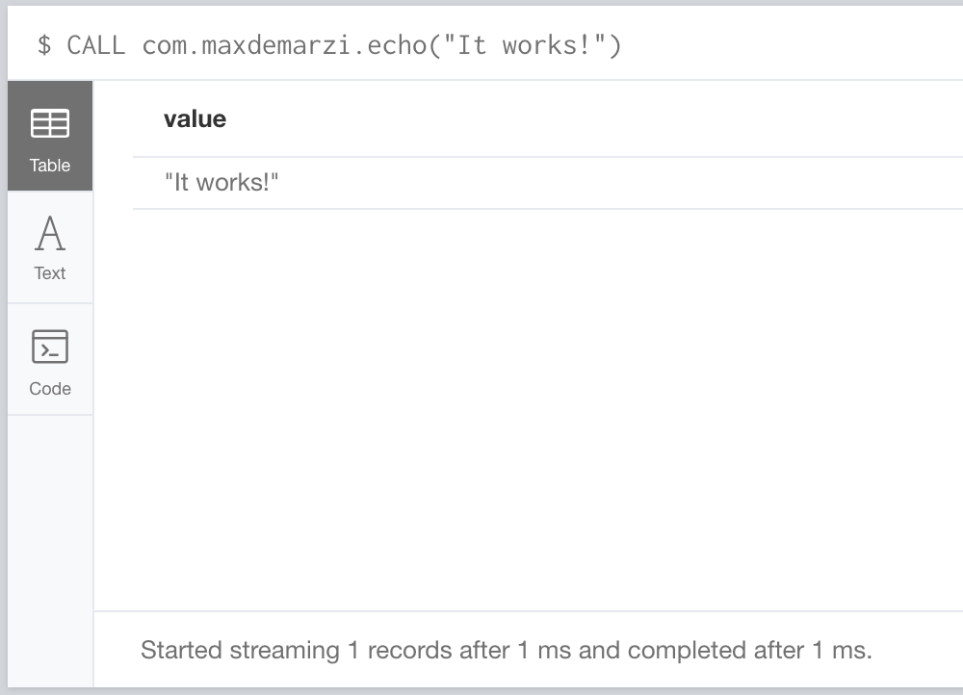
CALL com.maxdemarzi.echo("It works!");

Slide 105

What is this value?
No really, where does it come from?

Slide 106

Right there
The name(s) you give your Results matter.
If you only have one, call it “value”.

Slide 107

Not there is not there
You can’t yield what is not there.

Slide 108
Testing
So we don’t have to keep restarting Neo4j.

Slide 109

Add a new Package
Right Click on “Java” inside the “test” folder.

Slide 110

Use com.your name again
Expand the Java directory and it will be there now.

Slide 111

Add a new Java Class
Right Click on your package name under “test/java”.

Slide 112

Call it EchoTest
Or whatever.

Slide 113
@Rule
public final Neo4jRule neo4j = new Neo4jRule()
.withProcedure(Procedures.class);
If you called your Procedures class anything other than “Procedures” then change this.

Slide 114
@Test
public void shouldEcho()
{
// In a try-block, to make sure we close the driver after the test
try( Driver driver = GraphDatabase.driver( neo4j.boltURI() ,
Config.build().withoutEncryption().toConfig() ) )
{
// Given I've started Neo4j with the procedure
// which my 'neo4j' rule above does.
Session session = driver.session();
// When I use the procedure
StatementResult result = session.run( "CALL com.maxdemarzi.echo($something)",
parameters( "something", "It works!" ) );
// Then I should get what I expect
assertThat(result.single().get("value").asString(), equalTo("It works!"));
}
}

Slide 115

Run the test
Right Click on “shouldEcho”.

Slide 116

It passes
It better.

Slide 117

Life
Is so depressing…

Slide 118

Create some data
Impressed >> Depressed

Slide 119
WITH [“Jennifer","Michelle","Tanya","Julie",
“Christie","Sophie","Amanda","Khloe","Sarah",
"Kaylee"] AS names
FOREACH (r IN range(0,100000) |
CREATE (:User {username:names[r %
size(names)]+r}))

Slide 120

100k Users
Hat tip to MH for this beauty.

Slide 121
MATCH (u1:User),(u2:User)
WITH u1,u2
LIMIT 5000000
WHERE rand() < 0.1
CREATE (u1)-[:FRIENDS]->(u2)

Slide 122

Warning
Cartesian products suck 99% of the time.

Slide 123

1% Exception
They make nice suits.

Slide 124

Run it
It will create around 500k relationships.

Slide 125
CREATE INDEX ON :User(username);

Slide 126
MATCH (u:User)-[*1..4]->(c)
WHERE u.username = 'Khloe17'
RETURN count(DISTINCT c)

Slide 127

Takes about a second
Not bad.

Slide 128

Remove the arrow
MATCH (u:User)-[*1..4]->(c)

Slide 129

Spinner of death
WTF is taking so long?

Slide 130

Cypher
Has betrayed you.

Slide 131
Java Core API
How does it work, when do I use it, when do I not.

Slide 132

THe docs
https://neo4j.com/docs/java-reference/current/javadocs/

Slide 133

Add a new class
Right Click on “results” and add it.

Slide 134

Call it Longresult
It will return a Long… duh.

Slide 135
public class LongResult {
public static final LongResult NULL = new LongResult(null);
public final Long value;
public LongResult(Long value) {
this.value = value;
}
}

Slide 136

TDD
For Realz Yo.

Slide 137

Add a new Class
Right Click on your package directory under “test”.

Slide 138

Call it something
As long as it ends in Test we’re cool.

Slide 139
public class NetworkCountTest {
@Rule
public final Neo4jRule neo4j = new Neo4jRule()
.withProcedure(Procedures.class)
.withFixture(MODEL_STATEMENT);

Slide 140
private static final String MODEL_STATEMENT =
"CREATE (n1:User { username:'User-1' })" +
"CREATE (n2:User { username:'User-2' })" +
"CREATE (n3:User { username:'User-3' })" +
"CREATE (n4:User { username:'User-4' })" +
"CREATE (n5:User { username:'User-5' })" +
"CREATE (n6:User { username:'User-6' })" +
"CREATE (n1)-[:FRIENDS]->(n3)" +
"CREATE (n2)-[:FRIENDS]->(n3)" +
"CREATE (n2)-[:FRIENDS]->(n1)" +
"CREATE (n3)-[:FRIENDS]->(n4)" +
"CREATE (n4)-[:FRIENDS]->(n5)" +
"CREATE (n6)-[:FRIENDS]->(n4)";

Slide 141
@Test
public void shouldNetworkCount()
{
// In a try-block, to make sure we close the driver after the test
try( Driver driver = GraphDatabase.driver( neo4j.boltURI() ,
Config.build().withoutEncryption().toConfig() ) )
{
// Given I've started Neo4j with the procedure
// which my 'neo4j' rule above does.
Session session = driver.session();
// When I use the procedure
StatementResult result = session.run(
"CALL com.maxdemarzi.network.count($username, $distance)",
parameters( "username", "User-1", "distance", 3 ) );
// Then I should get what I expect
assertThat(result.single().get("value").asLong(), equalTo(5L));
}
}

Slide 142
@Procedure(name = "com.maxdemarzi.network.count", mode = Mode.READ)
@Description("CALL com.maxdemarzi.network.count(String said)")
public Stream<LongResult> networkCount(@Name("username") String username,
@Name(value="distance", defaultValue = "1") Long distance) {
if (distance < 1) return Stream.empty();
Node user = db.findNode(Label.label("User"), "username", username);
if (user == null) {
return Stream.empty();
} else {

Slide 143
Iterator<Node> iterator;
Node current;
HashSet<Node> seen = new HashSet<>();
HashSet<Node> nextA = new HashSet<>();
HashSet<Node> nextB = new HashSet<>();
seen.add(user);

Slide 144
// First Hop
for (Relationship r : user.getRelationships()) {
nextB.add(r.getOtherNode(user));
}

Slide 145
for(int i = 1; i < distance; i++) {
// next even Hop
nextB.removeAll(seen);
seen.addAll(nextB);
nextA.clear();
iterator = nextB.iterator();
while (iterator.hasNext()) {
current = iterator.next();
for (Relationship r : current.getRelationships()) {
nextA.add(r.getOtherNode(current));
}
}
i++;

Slide 146
if (i < distance) {
// next odd Hop
nextA.removeAll(seen);
seen.addAll(nextA);
nextB.clear();
iterator = nextB.iterator();
while (iterator.hasNext()) {
current = iterator.next();
for (Relationship r : current.getRelationships()) {
nextA.add(r.getOtherNode(current));
}
}
}
}

Slide 147
if((distance % 2) == 0) {
seen.addAll(nextA);
} else {
seen.addAll(nextB);
}
// remove starting node
seen.remove(user);
return Stream.of(new LongResult((long) seen.size()));

Slide 148

Test it
Right Click on ShouldNetworkCount.

Slide 149

It Fails
WTF!!!

Slide 150

Bug
Find it, fix it.

Slide 151

Debug
Add a “breakpoint” and click the debug icon (seen on top right).

Slide 152

Here it is
We clear nextB and then iterate over it?
Copy and paste botch. Switch nextA and nextB.

Slide 153
if (i < distance) {
// next odd Hop
nextA.removeAll(seen);
seen.addAll(nextA);
nextB.clear();
iterator = nextA.iterator();
while (iterator.hasNext()) {
current = iterator.next();
for (Relationship r : current.getRelationships()) {
nextB.add(r.getOtherNode(current));
}
}
}
}

Slide 154
Test it Again
Right Click on ShouldNetworkCount.

Slide 155

It passes
It better

Slide 156


Slide 157
Package it Again
Find the “Maven Projects” side tab, expand “Lifecyle”, double click on “package”.

Slide 158
Copy it Again
Into your plugins folder.
Just like the README.md said.
And restart your Neo4j.

Slide 159

30 seconds
Sloooooooooooow.

Slide 160

300 ms
Eat that Cypher…and we got the right answer not off by 1.

Slide 161

that was hard
That’s a lot of code for 3 lines of Cypher.

Slide 162
Traversal API
How does it work, when do I use it, when do I not.

Slide 163

What is cypher doing?
We will do the same.

Slide 164
@Procedure(name = "com.maxdemarzi.network.count2", mode = Mode.READ)
@Description("CALL com.maxdemarzi.network.count2(String said)")
public Stream<LongResult> networkCount2(@Name(“username") String username,
@Name(value="distance", defaultValue = "1") Long distance) {
if (distance < 1) return Stream.empty();
Node user = db.findNode(Label.label("User"), "username", username);
if (user == null) {
return Stream.empty();
} else {

Slide 165
} else {
HashSet<Node> nodes = new HashSet<>();
TraversalDescription td = db.traversalDescription()
.depthFirst()
.expand(PathExpanders.allTypesAndDirections())
.evaluator(Evaluators.toDepth(distance.intValue()))
.uniqueness(Uniqueness.RELATIONSHIP_PATH);
for (Path ignored : td.traverse(user)) {
nodes.add(ignored.endNode());
}
// remove starting node
nodes.remove(user);
return Stream.of(new LongResult((long)nodes.size()));
}

Slide 166
@Test
public void shouldNetworkCount2()
{
// In a try-block, to make sure we close the driver after the test
try( Driver driver = GraphDatabase.driver( neo4j.boltURI() ,
Config.build().withoutEncryption().toConfig() ) )
{
// Given I've started Neo4j with the procedure
// which my 'neo4j' rule above does.
Session session = driver.session();
// When I use the procedure
StatementResult result = session.run(
"CALL com.maxdemarzi.network.count2($username, $distance)",
parameters( "username", "User-1", "distance", 3 ) );
// Then I should get what I expect
assertThat(result.single().get("value").asLong(), equalTo(5L));
}
}

Slide 167

Way easier no?
Is it slower? Is it faster?

Slide 168
Package it Again
Find the “Maven Projects” side tab, expand “Lifecyle”, double click on “package”.

Slide 169
Copy it Again
Into your plugins folder.
Just like the README.md said.
And restart your Neo4j.

Slide 170

3 minutes
WTF?
It’s what the “old” cypher used to do.

Slide 171

That is really dumb
Can we do better?

Slide 172
@Procedure(name = "com.maxdemarzi.network.count3", mode = Mode.READ)
@Description("CALL com.maxdemarzi.network.count3(String said)")
public Stream<LongResult> networkCount3(@Name(“username”) String username,
@Name(value="distance", defaultValue = "1") Long distance) {
if (distance < 1) return Stream.empty();
Node user = db.findNode(Label.label("User"), "username", username);
if (user == null) {
return Stream.empty();
} else {

Slide 173
} else {
TraversalDescription td = db.traversalDescription()
.breadthFirst()
.expand(PathExpanders.allTypesAndDirections())
.evaluator(Evaluators.toDepth(distance.intValue()))
.uniqueness(Uniqueness.NODE_GLOBAL);
int count = 0;
for (Path ignored : td.traverse(user)) {
count++;
}
// remove starting node
count--;
return Stream.of(new LongResult((long) count));
}

Slide 174
@Test
public void shouldNetworkCount3()
{
// In a try-block, to make sure we close the driver after the test
try( Driver driver = GraphDatabase.driver( neo4j.boltURI() ,
Config.build().withoutEncryption().toConfig() ) )
{
// Given I've started Neo4j with the procedure
// which my 'neo4j' rule above does.
Session session = driver.session();
// When I use the procedure
StatementResult result = session.run(
"CALL com.maxdemarzi.network.count3($username, $distance)",
parameters( "username", "User-1", "distance", 3 ) );
// Then I should get what I expect
assertThat(result.single().get("value").asLong(), equalTo(5L));
}
}

Slide 175
Package it Again
Find the “Maven Projects” side tab, expand “Lifecyle”, double click on “package”.

Slide 176
Copy it Again
Into your plugins folder.
Just like the README.md said.
And restart your Neo4j.

Slide 177

300 ms
Now we’re talking.

Slide 178

Can we go faster?
The answer is always yes.

Slide 179
Instead of Nodes
Use Longs

Slide 180

215 ms
Nice.

Slide 181

Can we go faster?
The answer is always yes.

Slide 182
Instead of Longs
Use Compressed bitmaps

Slide 183

135 ms
Real Niceeeeeeeeee.

Slide 184
Lunch
Eat something.

Slide 185
Cheating
Caching, High Speed Libraries, Dictionary Encoding…

Slide 186
Testing
Performance, Profiling, Examples

Slide 187

gatling.io
Download it.

Slide 188
Analytics
Writing to Disk, Order to Simulate Grouping, Batching, more…

